Slide 1
MA
2). Performance – Total with Asset Classes (Table)
Description: This object displays performance at the total portfolio and asset class levels. **Please Note: In order for this object to display data properly, you must calculate asset class level performance in your portfolio accounting system.
<Performance>
 |  | <colm. 1> | <colm. 2> | <colm. 3> | <colm. 4> | <colm. 5> | <colm. 6> | <colm. 7> | <colm. 8>
 | <asset class> | <nn.nn%> | <nn.nn%> | <nn.nn%> | <nn.nn%> | <nn.nn%> | <nn.nn%> | <nn.nn%> | <nn.nn%>
 | <asset class> | <nn.nn%> | <nn.nn%> | <nn.nn%> | <nn.nn%> | <nn.nn%> | <nn.nn%> | <nn.nn%> | <nn.nn%>
 | <asset class> | <nn.nn%> | <nn.nn%> | <nn.nn%> | <nn.nn%> | <nn.nn%> | <nn.nn%> | <nn.nn%> | <nn.nn%>
 | <asset class> | <nn.nn%> | <nn.nn%> | <nn.nn%> | <nn.nn%> | <nn.nn%> | <nn.nn%> | <nn.nn%> | <nn.nn%>
 | Total Portfolio | <nn.nn%> | <nn.nn%> | <nn.nn%> | <nn.nn%> | <nn.nn%> | <nn.nn%> | <nn.nn%> | <nn.nn%>
<footnotes>
Notes:
** Sort order: default asset class order
**Footnotes – show the performance type based on the setting. If “Since Inception” is selected as a column, then add semi-colon and inception date as below. . If any asset class inception date differs from account inception date, then show the total and asset classes separately as below.
E.g. Inception Date: Total Portfolio – mm/dd/yyyy; Equity – mm/dd/yyyy; etc.
a). Performance is gross/net of fees; Inception Date: mm/dd/yyyy
**Note date format is sensitive to client config. parameter.
Settings:
**Common perf. Settings EXCEPT benchmark selection setting.
Setting Name: Horizontal alignment
Type: dropdown
Values (for drop downs): left; center; right; none
Default Value: center
Help Text:
Selecting "left" or "right" will align the object to the left or right margin of the page. "Center" will keep the object centered on the page. Selecting "none" will keep the object exactly as you placed it on the page - if the object is of variable width (e.g. performance object with different periods for different accounts), then the left edge of the object will remain in the position the object was placed and the width will expand/shrink to/from the right side.
Number Formatting
**Decimal places on all columns: Default for % - 2 decimals.

Slide 2
MA
3). Performance – One Asset Class with Total and Indices (Table)
Description: This object displays performance for the total portfolio and one asset class along with up to two indices. **Please Note: In order for this object to display data properly, you must calculate asset class level performance in your portfolio accounting system.
<Performance>
 |  | <colm. 1> | <colm. 2> | <colm. 3> | <colm. 4> | <colm. 5> | <colm. 6> | <colm. 7> | <colm. 8>
 | Total Portfolio | <nn.nn%> | <nn.nn%> | <nn.nn%> | <nn.nn%> | <nn.nn%> | <nn.nn%> | <nn.nn%> | <nn.nn%>
 | <asset class> | <nn.nn%> | <nn.nn%> | <nn.nn%> | <nn.nn%> | <nn.nn%> | <nn.nn%> | <nn.nn%> | <nn.nn%>
 | <index> | <nn.nn%> | <nn.nn%> | <nn.nn%> | <nn.nn%> | <nn.nn%> | <nn.nn%> | <nn.nn%> | <nn.nn%>
 | <index> | <nn.nn%> | <nn.nn%> | <nn.nn%> | <nn.nn%> | <nn.nn%> | <nn.nn%> | <nn.nn%> | <nn.nn%>
<footnotes>
Notes:
**Footnotes – show the performance type based on the setting. If “Since Inception” is selected as a column, then add semi-colon and inception date as below. . If any asset class inception date differs from account inception date, then show the total and asset classes separately as below.
E.g. Inception Date: Total Portfolio – mm/dd/yyyy; Equity – mm/dd/yyyy; etc.
a). Performance is gross/net of fees; Inception Date: mm/dd/yyyy
**Note date format is sensitive to client config. parameter.
Settings:
**Common perf. Settings
Setting Name: Asset class
Type: dropdown
Values (for drop downs): {list of asset classes with perf.}
Default Value: {first in list}
Help Text:
Setting Name: Horizontal alignment
Type: dropdown
Values (for drop downs): left; center; right; none
Default Value: center
Help Text:
Selecting "left" or "right" will align the object to the left or right margin of the page. "Center" will keep the object centered on the page. Selecting "none" will keep the object exactly as you placed it on the page - if the object is of variable width (e.g. performance object with different periods for different accounts), then the left edge of the object will remain in the position the object was placed and the width will expand/shrink to/from the right side.
Number Formatting
**Decimal places on all columns: Default for % - 2 decimals.

Slide 3
MA
4). Performance – Two Asset Classes with Total and Indices (Table)
Description: This object displays performance for the total portfolio and two asset classes along with indices for each. **Please Note: In order for this object to display data properly, you must calculate asset class level performance in your portfolio accounting system.
<Performance>
 |  | <colm. 1> | <colm. 2> | <colm. 3> | <colm. 4> | <colm. 5> | <colm. 6> | <colm. 7> | <colm. 8>
 | Total Portfolio | <nn.nn%> | <nn.nn%> | <nn.nn%> | <nn.nn%> | <nn.nn%> | <nn.nn%> | <nn.nn%> | <nn.nn%>
 | <index> | <nn.nn%> | <nn.nn%> | <nn.nn%> | <nn.nn%> | <nn.nn%> | <nn.nn%> | <nn.nn%> | <nn.nn%>
 | <asset class> | <nn.nn%> | <nn.nn%> | <nn.nn%> | <nn.nn%> | <nn.nn%> | <nn.nn%> | <nn.nn%> | <nn.nn%>
 | <index> | <nn.nn%> | <nn.nn%> | <nn.nn%> | <nn.nn%> | <nn.nn%> | <nn.nn%> | <nn.nn%> | <nn.nn%>
 | <asset class> | <nn.nn%> | <nn.nn%> | <nn.nn%> | <nn.nn%> | <nn.nn%> | <nn.nn%> | <nn.nn%> | <nn.nn%>
 | <index> | <nn.nn%> | <nn.nn%> | <nn.nn%> | <nn.nn%> | <nn.nn%> | <nn.nn%> | <nn.nn%> | <nn.nn%>
<footnotes>
Notes:
**Footnotes – show the performance type based on the setting. If “Since Inception” is selected as a column, then add semi-colon and inception date as below. . If any asset class inception date differs from account inception date, then show the total and asset classes separately as below.
E.g. Inception Date: Total Portfolio – mm/dd/yyyy; Equity – mm/dd/yyyy; etc.
a). Performance is gross/net of fees; Inception Date: mm/dd/yyyy
**Note date format is sensitive to client config. parameter.
Settings:
**Common perf. Settings
**1 Benchmark selection setting for Total Portfolio. Default = default 1.
Setting Name: Asset class 1
Type: dropdown
Values (for drop downs): keep blank, {list of asset classes with perf.}
Default Value: {first in list}
Help Text:
Setting Name: Asset class 1 - Benchmark
Type: dropdown
Values (for drop downs): {list of benchmarks}
Default Value: keep blank
Help Text:
Setting Name: Asset class 2
Type: dropdown
Values (for drop downs): keep blank, {list of asset classes with perf.}
Default Value: {first in list}
Help Text:
Setting Name: Asset class 2 - Benchmark
Type: dropdown
Values (for drop downs): {list of benchmarks}
Default Value: keep blank
Help Text:
Setting Name: Horizontal alignment
Type: dropdown
Values (for drop downs): left; center; right; none
Default Value: center
Help Text:
Selecting "left" or "right" will align the object to the left or right margin of the page. "Center" will keep the object centered on the page. Selecting "none" will keep the object exactly as you placed it on the page - if the object is of variable width (e.g. performance object with different periods for different accounts), then the left edge of the object will remain in the position the object was placed and the width will expand/shrink to/from the right side.
Number Formatting
**Decimal places on all columns: Default for % - 2 decimals.

Slide 4
MA
5). Performance – Multiple Periods and Indices (Table)
Description: This object allows you to select multiple return periods along with up to two indices. Available indices are the ones maintained in your portfolio accounting system.
<Performance>
 |  | <colm. 1> | <colm. 2> | <colm. 3> | <colm. 4> | <colm. 5> | <colm. 6> | <colm. 7> | <colm. 8>
 | <portfolio> | <nn.nn%> | <nn.nn%> | <nn.nn%> | <nn.nn%> | <nn.nn%> | <nn.nn%> | <nn.nn%> | <nn.nn%>
 | <index 1> | <nn.nn%> | <nn.nn%> | <nn.nn%> | <nn.nn%> | <nn.nn%> | <nn.nn%> | <nn.nn%> | <nn.nn%>
 | <index 2> | <nn.nn%> | <nn.nn%> | <nn.nn%> | <nn.nn%> | <nn.nn%> | <nn.nn%> | <nn.nn%> | <nn.nn%>
<footnotes>
Settings:
**Common perf. settings
Setting Name: On “Portfolio” row, show
Type: dropdown
Values (for drop downs): “Portfolio”; friendly name; actual account name
Default Value: “Portfolio”
Help Text: This setting determines if the word “Portfolio”, the friendly name or the actual account name is displayed on the first row. If you select “friendly name” and If a friendly name is not setup, the actual account name will be used. The friendly names are setup via the Account Administration tool.
Setting Name: Horizontal alignment
Type: dropdown
Values (for drop downs): left; center; right; none
Default Value: center
Help Text:
Selecting "left" or "right" will align the object to the left or right margin of the page. "Center" will keep the object centered on the page. Selecting "none" will keep the object exactly as you placed it on the page - if the object is of variable width (e.g. performance object with different periods for different accounts), then the left edge of the object will remain in the position the object was placed and the width will expand/shrink to/from the right side.
Number Formatting
**Decimal places on all columns: Default for % - 2 decimals.
Changes (07/30/12):
a). Shell change - added <> to “Portfolio” on first row since this could be changed via setting
b). Bug fix in “On ‘Portfolio’ row, show” setting -> Help Text
Notes:
** Sort order: default asset class order
**Footnotes – show the performance type based on the setting. If “Since Inception” is selected as a column, then add semi-colon and inception date as below.
a). Performance is gross/net of fees; Inception Date: mm/dd/yyyy
**Note date format is sensitive to client config. parameter.
b). If Blended indices are selected, add a separate footnote line for each blended index as below –
{blended index name}: {component1 name} {%}, {component2 name} {%}, …

Slide 5
6). Performance – Multiple Periods, Index and Value Added (Table)
Description: This object displays multiple return periods, one index, and a “Value Added” line displaying the difference between the portfolio returns and the returns of the selected index.
<Performance>
 |  | <colm. 1> | <colm. 2> | <colm. 3> | <colm. 4> | <colm. 5> | <colm. 6> | <colm. 7> | <colm. 8>
 | <portfolio> | <nn.nn%> | <nn.nn%> | <nn.nn%> | <nn.nn%> | <nn.nn%> | <nn.nn%> | <nn.nn%> | <nn.nn%>
 | <index> | <nn.nn%> | <nn.nn%> | <nn.nn%> | <nn.nn%> | <nn.nn%> | <nn.nn%> | <nn.nn%> | <nn.nn%>
 | Value Added | <nn.nn%> | <nn.nn%> | <nn.nn%> | <nn.nn%> | <nn.nn%> | <nn.nn%> | <nn.nn%> | <nn.nn%>
<footnotes>
Settings:
**Common perf. Settings
Setting Name: On “Portfolio” row, show
Type: dropdown
Values (for drop downs): “Portfolio”; friendly name; actual account name
Default Value: “Portfolio”
Help Text: This setting determines if the word “Portfolio”, the friendly name or the actual account name is displayed on the first row. If you select “friendly name” and If a friendly name is not setup, the actual account name will be used. The friendly names are setup via the Account Administration tool.
Setting Name: Show composite data
Type: dropdown
Values (for drop downs): yes; no
Default Value: no
Help Text: This setting applies to client accounts (non-composites). When generating reports for an account, if data displayed in this object is available for the account, then the account specific data will be used. Instead, if you want to display composite-level data, then select “yes” here – the data for the composite the account belongs to will be displayed. If you do not send account-level data for this object, then composite-level data will be used automatically. When generating reports for a composite, the actual composite data will be used (as long as the data is sent to Assette) irrespective of the selection. If you select to display composite data, you may select to display the footnote “Portfolio data is based on <composite name> data”. If there is no account data, and composite data is displayed, then the footnote will automatically be displayed. **Please note: Composite data is not available in Assette Easy products, hence this setting is not applicable.
  Setting Name: Display footnote
  Type: dropdown
  Values (for drop downs): yes; no
  Default Value: yes
Setting Name: Horizontal alignment
Type: dropdown
Values (for drop downs): left; center; right; none
Default Value: center
Help Text:
Selecting "left" or "right" will align the object to the left or right margin of the page. "Center" will keep the object centered on the page. Selecting "none" will keep the object exactly as you placed it on the page - if the object is of variable width (e.g. performance object with different periods for different accounts), then the left edge of the object will remain in the position the object was placed and the width will expand/shrink to/from the right side.
Number Formatting
**Decimal places on all columns: Default for % - 2 decimals.
Notes:
Changes (07/30/12):
a). Shell change - added <> to “Portfolio” on first row since this could be changed via setting
b). Bug fix in “On ‘Portfolio’ row, show” setting -> Help Text
** Sort order: default asset class order
**Footnotes – show the performance type based on the setting. If “Since Inception” is selected as a column, then add semi-colon and inception date as below.
a). Performance is gross/net of fees; Inception Date: mm/dd/yyyy
**Note date format is sensitive to client config. parameter.
b). If Blended indices are selected, add a separate footnote line for each blended index as below –
{blended index name}: {component1 name} {%}, {component2 name} {%}, …

Slide 6
MA
7). Performance – Cumulative and Annualized Since Inception (Table)
Description: This object displays the cumulative and annualized return since inception.
Settings:
**Common perf. settings
Setting Name: On “Portfolio” row, show
Type: dropdown
Values (for drop downs): “Portfolio”; friendly name; actual account name
Default Value: “Portfolio”
Help Text: This setting determines if the word “Portfolio”, the friendly name or the actual account name is displayed on the first row. If you select “friendly name” and If a friendly name is not setup, the actual account name will be used. The friendly names are setup via the Account Administration tool.
Number Formatting
**Decimal places on all columns: Default for % - 2 decimals.
<Performance Since Inception>
 |  | Cumulative | Annualized
 | <portfolio> | <nn.nn%> | <nn.nn%>
 | <index 1> | <nn.nn%> | <nn.nn%>
 | <index 2> | <nn.nn%> | <nn.nn%>
Inception date: mm/dd/yyyy
<footnotes>
Notes:
Changes (07/30/12):
a). Shell change - added <> to “Portfolio” on first row since this could be changed via setting
b). Bug fix in “On ‘Portfolio’ row, show” setting -> Help Text
**Footnotes – inception date is the first; performance type based on the setting.
**Note date format is sensitive to client config. parameter.
b). If Blended indices are selected, add a separate footnote line for each blended index as below –
{blended index name}: {component1 name} {%}, {component2 name} {%}, …

Slide 7
MA
8). Performance – Index Returns (Table)
Description: This object displays returns for different time periods for up to ten indices.
<Index Performance>
 |  | <colm. 1> | <colm. 2> | <colm. 3> | <colm. 4> | <colm. 5> | <colm. 6> | <colm. 7> | <colm. 8>
 | <index 1> | <nn.nn%> | <nn.nn%> | <nn.nn%> | <nn.nn%> | <nn.nn%> | <nn.nn%> | <nn.nn%> | <nn.nn%>
 | <index 2> | <nn.nn%> | <nn.nn%> | <nn.nn%> | <nn.nn%> | <nn.nn%> | <nn.nn%> | <nn.nn%> | <nn.nn%>
 | <index 3> | <nn.nn%> | <nn.nn%> | <nn.nn%> | <nn.nn%> | <nn.nn%> | <nn.nn%> | <nn.nn%> | <nn.nn%>
 | <index 4> | <nn.nn%> | <nn.nn%> | <nn.nn%> | <nn.nn%> | <nn.nn%> | <nn.nn%> | <nn.nn%> | <nn.nn%>
 | <index 5> | <nn.nn%> | <nn.nn%> | <nn.nn%> | <nn.nn%> | <nn.nn%> | <nn.nn%> | <nn.nn%> | <nn.nn%>
<footnotes>
Settings:
**Common perf. Settings: INDEX SETTINGS – UP TO 10 Indices (10 Rows)
Setting Name: Horizontal alignment
Type: dropdown
Values (for drop downs): left; center; right; none
Default Value: center
Help Text:
Selecting "left" or "right" will align the object to the left or right margin of the page. "Center" will keep the object centered on the page. Selecting "none" will keep the object exactly as you placed it on the page - if the object is of variable width (e.g. performance object with different periods for different accounts), then the left edge of the object will remain in the position the object was placed and the width will expand/shrink to/from the right side.
Number Formatting
**Decimal places on all columns: Default for % - 2 decimals.
Notes:
** Sort order: default asset class order
** If Blended indices are selected, add a separate footnote line for each blended index as below –
{blended index name}: {component1 name} {%}, {component2 name} {%}, …

Slide 8
MA
9). Performance – Fund Performance (Table)
Description: This object displays up to four periods of performance for any funds held in the portfolio. Fund performance is irrespective of the portfolio’s actual holding period. **Please Note: In order for this object to display data, Assette needs to receive fund values from you. This data is typically provided via Excel template.
<Fund Performance>
Fund | Value | Percent of Portfolio | <colm. 1> | <colm. 2> | <colm. 3> | <colm. 4> | <Category>
<fund> | <$nn,nnn,nnn> | <nn.nn%> | <nn.nn%> | <nn.nn%> | <nn.nn%> | <nn.nn%> | <asset class>
<fund> | <$nn,nnn,nnn> | <nn.nn%> | <nn.nn%> | <nn.nn%> | <nn.nn%> | <nn.nn%> | <asset class>
<fund> | <$nn,nnn,nnn> | <nn.nn%> | <nn.nn%> | <nn.nn%> | <nn.nn%> | <nn.nn%> | <asset class>
<fund> | <$nn,nnn,nnn> | <nn.nn%> | <nn.nn%> | <nn.nn%> | <nn.nn%> | <nn.nn%> | <asset class>
TOTAL | <$nn,nnn,nnn> | <nn.nn%>
Fund performance irrespective of your portfolio’s actual holding period.
<footnotes>
Notes:
** Sort order: value, DSC
**Footnotes – show the performance type based on the setting.
**Need to keep Security Type to identify Funds as Client Config. Parameter (we can have defaults for Axys, APX and PC).
**This object should ONLY show certain periods as settings values. We should stick to the 6 periods we extract via extensions, and make the fund perf. Excel template have only these 6.
Settings:
**Common perf. Settings **See comment on left re: periods and settings values. Allow these values for up to 4 columns.
Setting Name: Show “% of Portfolio”
Type: dropdown
Values (for drop downs): yes; no
Default Value: yes
Help Text:
Setting Name: Category
Type: dropdown
Values (for drop downs): asset class; sector; industry; security type; do not show
Default Value: sector
Help Text: This setting determines the values listed in the <Category> column. The asset class, sector, industry or security type codes for each security as coded in your portfolio accounting system will be used to determine the subcategories. **Please note: in Schwab PortfolioCenter, “industry” is referred to as “subsector”. You may hide this column be selecting “do not show”.
  Setting Name: Column heading
  Type: text entry box
  Values (for drop downs): blank
  Default Value: center
  Help Text: If you want the column heading to display text other than the selection, enter the column heading here. Keeping this setting blank will display the name of the selection - Asset Class; Sector; Industry or Security Type.
Setting Name: Horizontal alignment
Type: dropdown
Values (for drop downs): left; center; right; none
Default Value: center
Help Text:
Selecting "left" or "right" will align the object to the left or right margin of the page. "Center" will keep the object centered on the page. Selecting "none" will keep the object exactly as you placed it on the page - if the object is of variable width (e.g. performance object with different periods for different accounts), then the left edge of the object will remain in the position the object was placed and the width will expand/shrink to/from the right side.
Number Formatting
**Decimal places on all columns: Default for % - 2 decimals.

Slide 9
MA
10). Performance – Position Performance Summary by Asset Class (Table)
Description: This object displays internal rate of return (IRR) at the position level, categorized by asset class. **Please Note: This object is available only if you are using Schwab PortfolioCenter.
<Position Performance>
Asset Class and Security |  | Value | Purchase Date | <colm. 1> | <colm. 2> | <colm. 3> | <colm. 4> | <colm. 5>
 | <asset class>
<security> |  | <$nn,nnn,nnn> | mm/dd/yyyy | <nn.nn%> | <nn.nn%> | <nn.nn%> | <nn.nn%> | <nn.nn%>
<security> |  | <$nn,nnn,nnn> | mm/dd/yyyy | <nn.nn%> | <nn.nn%> | <nn.nn%> | <nn.nn%> | <nn.nn%>
Subtotal |  | <$nn,nnn,nnn> |  | <nn.nn%> | <nn.nn%> | <nn.nn%> | <nn.nn%> | <nn.nn%>
 | <asset class>
<security> |  | <$nn,nnn,nnn> | mm/dd/yyyy | <nn.nn%> | <nn.nn%> | <nn.nn%> | <nn.nn%> | <nn.nn%>
<security> |  | <$nn,nnn,nnn> | mm/dd/yyyy | <nn.nn%> | <nn.nn%> | <nn.nn%> | <nn.nn%> | <nn.nn%>
Subtotal |  | <$nn,nnn,nnn> |  | <nn.nn%> | <nn.nn%> | <nn.nn%> | <nn.nn%> | <nn.nn%>
TOTAL PORTFOLIO |  | <$nn,nnn,nnn> |  | <nn.nn%> | <nn.nn%> | <nn.nn%> | <nn.nn%> | <nn.nn%>
<footnotes>
Notes:
**Footnotes – show the performance type based on the setting.
Show Purchase Date: yes; no
Add other columns: Start value; adds, sales, etc. and ONE IRR period.
Settings:
**Common perf. Settings – for IRR periods.
Setting Name: Sort by
Type: dropdown
Values (for drop downs): default asset class order; asset class value, ascending; asset class value, descending
Default Value: default asset class order
Help Text:
Setting Name: Secondary sort by
Type: dropdown
Values (for drop downs): Value, descending; Purchase Date, ascending
Default Value: Value, descending
Help Text:
Number Formatting
**Decimal places on all columns: Default for % - 2 decimals. MV – zero decimals.
Currency formatting on all dollar columns.

Slide 10
MA
12). Performance – Position Performance Detail by Asset Class (Table)
Description: This object displays internal rate of return (IRR) at the position level, categorized by asset class. **Please Note: This object is available only if you are using Schwab PortfolioCenter.
<Position Performance Detail (mm/dd/yyyy – mm/dd/yyyy)>
Asset Class and Security |  | Value on <mm/dd/yyyy> | Additions /Purchases | Withdrawals /Sales | Realized Gain/Loss | Unrealized Gain/Loss | Net Income / Expenses | Value on <mm/dd/yyyy> | <IRR>
 | <asset class>
<security> |  | <$nn,nnn,nnn> | <$nn,nnn,nnn> | <$nn,nnn,nnn> | <$nnn,nnn> | <$nnn,nnn> | <$nnn,nnn> | <$nn,nnn,nnn> | <nn.nn%>
<security> |  | <$nn,nnn,nnn> | <$nn,nnn,nnn> | <$nn,nnn,nnn> | <$nnn,nnn> | <$nnn,nnn> | <$nnn,nnn> | <$nn,nnn,nnn> | <nn.nn%>
Subtotal |  | <$nn,nnn,nnn> | <$nn,nnn,nnn> | <$nn,nnn,nnn> | <$nnn,nnn | <$nnn,nnn | <$nnn,nnn | <$nn,nnn,nnn> | <nn.nn%>
 | <asset class>
<security> |  | <$nn,nnn,nnn> | <$nn,nnn,nnn> | <$nn,nnn,nnn> | <$nnn,nnn> | <$nnn,nnn> | <$nnn,nnn> | <$nn,nnn,nnn> | <nn.nn%>
<security> |  | <$nn,nnn,nnn> | <$nn,nnn,nnn> | <$nn,nnn,nnn> | <$nnn,nnn> | <$nnn,nnn> | <$nnn,nnn> | <$nn,nnn,nnn> | <nn.nn%>
Subtotal |  | <$nn,nnn,nnn> | <$nn,nnn,nnn> | <$nn,nnn,nnn> | <$nnn,nnn> | <$nnn,nnn> | <$nnn,nnn> | <$nn,nnn,nnn> | <nn.nn%>
TOTAL PORTFOLIO |  | <$nn,nnn,nnn> | <$nn,nnn,nnn> | <$nn,nnn,nnn> | <$nnn,nnn> | <$nnn,nnn> | <$nnn,nnn> | <$nn,nnn,nnn> | <nn.nn%>
<footnotes>
Notes:
**Footnotes – show the performance type based on the setting.
Show Purchase Date: yes; no
Add other columns: Start value; adds, sales, etc. and ONE IRR period.
Settings:
**Common perf. Settings – for IRR periods (can only select 1).
Setting Name: Sort by
Type: dropdown
Values (for drop downs): default asset class order; asset class value, ascending; asset class value, descending
Default Value: default asset class order
Help Text:
Setting Name: Secondary sort by
Type: dropdown
Values (for drop downs): Value (ending), descending; Value (ending), ascending; Purchase Date, ascending; Purchase Date, descending; Security, ascending
Default Value: Value (ending), descending
Help Text:
Number Formatting
**Decimal places on all columns: Default for % - 2 decimals. MV – zero decimals.
Currency formatting on all dollar columns.

Slide 11
MA
13). Performance – [Group] Total with Asset Classes and Indices (Table)
Description: This object works on a combined group account where the combined account provides the total portfolio figures and each sub-account in the group provides data for an asset class. Up to two benchmarks associated with combined account and each sub-account will be displayed.
<Performance>
 | <colm. 1> | <colm. 2> | <colm. 3> | <colm. 4> | <colm. 5> | <colm. 6> | <colm. 7> | <colm. 8>
Total Portfolio | <nn.nn%> | <nn.nn%> | <nn.nn%> | <nn.nn%> | <nn.nn%> | <nn.nn%> | <nn.nn%> | <nn.nn%>
<index 1> | <nn.nn%> | <nn.nn%> | <nn.nn%> | <nn.nn%> | <nn.nn%> | <nn.nn%> | <nn.nn%> | <nn.nn%>
<index 2> | <nn.nn%> | <nn.nn%> | <nn.nn%> | <nn.nn%> | <nn.nn%> | <nn.nn%> | <nn.nn%> | <nn.nn%>
<asset class 1> | <nn.nn%> | <nn.nn%> | <nn.nn%> | <nn.nn%> | <nn.nn%> | <nn.nn%> | <nn.nn%> | <nn.nn%>
<index 1> | <nn.nn%> | <nn.nn%> | <nn.nn%> | <nn.nn%> | <nn.nn%> | <nn.nn%> | <nn.nn%> | <nn.nn%>
<index 2> | <nn.nn%> | <nn.nn%> | <nn.nn%> | <nn.nn%> | <nn.nn%> | <nn.nn%> | <nn.nn%> | <nn.nn%>
<asset class 2> | <nn.nn%> | <nn.nn%> | <nn.nn%> | <nn.nn%> | <nn.nn%> | <nn.nn%> | <nn.nn%> | <nn.nn%>
<index 1> | <nn.nn%> | <nn.nn%> | <nn.nn%> | <nn.nn%> | <nn.nn%> | <nn.nn%> | <nn.nn%> | <nn.nn%>
<index 2> | <nn.nn%> | <nn.nn%> | <nn.nn%> | <nn.nn%> | <nn.nn%> | <nn.nn%> | <nn.nn%> | <nn.nn%>
<footnotes>
Notes:
**Footnotes – show the performance type based on the setting. If “Since Inception” is selected as a column, then add semi-colon and inception date as below. If ITDs are different for each account, then will need to show a/c name – mm/dd/yyyy for each account. (please note: the account name should be sensitive to the ‘On “Total Portfolio” row, show’ setting and ‘ On “asset class” row, show’ settings.
a). Performance is gross/net of fees; Inception Date: mm/dd/yyyy OR
…; Equity – mm/dd/yyyy, Fixed Income – mm/dd/yyyy, etc.
** If Blended indices are selected, add a separate footnote line for each blended index as below –
{blended index name}: {component1 name} {%}, {component2 name} {%}, …
**Note date format is sensitive to client config. parameter.
Settings:
**Common perf. Settings EXCEPT benchmark selection setting.
Setting Name: On “Total Portfolio” row, show
Type: dropdown
Values (for drop downs): “Total Portfolio”; friendly name; actual account name
Default Value: “Total Portfolio”
Help Text: This setting determines if the word “Total Portfolio”, the friendly name or the actual account name is displayed. If you select “friendly name” and If a friendly name is not setup, the actual account name will be used. The friendly names are setup via the Account Administration tool.
Setting Name: On “asset class” row, show
Type: dropdown
Values (for drop downs): asset class name; friendly name; actual account name
Default Value: asset class name
Help Text: If “asset class name” is selected, then asset class coding of securities in the sub-accounts will be used to determine the asset class of each sub-account. If a sub-account has securities in multiple asset classes, then the asset class with the highest market value will determine the asset class. If you select “friendly name” and If a friendly name is not setup, the actual account name will be used. The friendly names are setup via the Account Administration tool.
Setting Name: Suppress Sub-Accounts ????
Type: entry box???
Values (for drop downs): blank
Default Value: asset class name
Help Text: Users can type text such as TIPS, etc. and if the word is there in Name1, exclude??? Should we give options??
Setting Name: Horizontal alignment
Type: dropdown
Values (for drop downs): left; center; right; none
Default Value: center
Help Text: Selecting "left" or "right" will align the object to the left or right margin of the page. "Center" will keep the object centered on the page. Selecting "none" will keep the object exactly as you placed it on the page - if the object is of variable width (e.g. performance object with different periods for different accounts), then the left edge of the object will remain in the position the object was placed and the width will expand/shrink to/from the right side.
Setting Name: Asset class sort order
Type: dropdown
Values (for drop downs): default asset class order; value of sub-account, descending; value of sub-account, ascending amount, descending; amount, ascending
Default Value: default asset class order
Help Text: If “default asset class order” is selected, then security type in the sub-accounts will be used to determine the asset class of each sub-account.
Number Formatting
**Decimal places on all columns: Default for % - 2 decimals.

Slide 12
MA
14). Performance – [Group] Total with Sub-Accounts (Table)
Description: This object works on a combined group account, and displays performance for the combined account and each sub-account in the group.
<Performance>
 |  | Inception Date | <colm. 1> | <colm. 2> | <colm. 3> | <colm. 4> | <colm. 5> | <colm. 6>
 | <account name> (<a/c number>) | mm/dd/yyyy | <nn.nn%> | <nn.nn%> | <nn.nn%> | <nn.nn%> | <nn.nn%> | <nn.nn%>
 | <account name> (<a/c number>) | mm/dd/yyyy | <nn.nn%> | <nn.nn%> | <nn.nn%> | <nn.nn%> | <nn.nn%> | <nn.nn%>
 | <account name> (<a/c number>) | mm/dd/yyyy | <nn.nn%> | <nn.nn%> | <nn.nn%> | <nn.nn%> | <nn.nn%> | <nn.nn%>
 | <account name> (<a/c number>) | mm/dd/yyyy | <nn.nn%> | <nn.nn%> | <nn.nn%> | <nn.nn%> | <nn.nn%> | <nn.nn%>
 | Total Portfolio | mm/dd/yyyy | <nn.nn%> | <nn.nn%> | <nn.nn%> | <nn.nn%> | <nn.nn%> | <nn.nn%>
<footnotes>
Notes:
**Footnotes –
a). Performance is gross/net of fees
**Note date format is sensitive to client config. parameter.
**Colors = first sub-account is #2 in PORTFOLIO AND SUB ACCOUNTS Palette (#1 is the combined account).
**If all sub-accounts are < 1yr, then do not show “Annualized” for ITD.
If all accounts are > 1yr, show “Annualized”.
If even one account is < 1 yr, do not show “Annualized”. In this case, put asterisk after “Since Inception”, and add the following footnote as the first footnote – “*Annualized for accounts open longer than 12 months”
Settings:
**Common perf. Settings EXCEPT benchmark selection setting.
Setting Name: Show account number
Type: dropdown
Values (for drop downs): yes; no
Default Value: yes
Help Text: If “yes” is selected, the last four digits of the account number will be displayed in parenthesis after the account name.
Setting Name: Show inception date
Type: dropdown
Values (for drop downs): yes; no
Default Value: yes
Help Text: This setting determines whether to display or hide the Inception Date column. If you select to display inception to date performance, then displaying this column is recommended. **Please note: unlike in other performance objects, a footnote with inception dates are not displayed in this object.
Setting Name: Use friendly name for a/c name
Type: dropdown
Values (for drop downs): yes; no
Default Value: no
Help Text: If “yes” is selected the identifier displayed for each account will be the “Friendly Name” you have specified for each account. Use the friendly name if you have long account names that could wrap into multiple rows, thus cluttering the report. The friendly names are setup via the Account Administration tool. If there is no friendly name for a particular account, then the actual account name will be used.
Setting Name: On “Total Portfolio” row, show
Type: dropdown
Values (for drop downs): “Total Portfolio”; friendly name; actual account name
Default Value: “Total Portfolio”
Help Text: This setting determines if the word “Total Portfolio”, the friendly name or the actual account name is displayed. If you select “friendly name” and If a friendly name is not setup, the actual account name will be used. The friendly names are setup via the Account Administration tool.
Setting Name: Show account type
Type: dropdown
Values (for drop downs): yes; no
Default Value: no
Help Text: If “yes” is selected, the account type will be displayed after the account name and number.
Setting Name: Sort by
Type: dropdown
Values (for drop downs): sub-account value, ascending; sub-account value, descending; sub-account name, ascending; sub-account name, descending; sub-account inception date, descending; sub-account inception date, ascending
Default Value: sub-account value, descending
Help Text: The “Total Portfolio” row is excluded from the sort, and will always be the first row.
Setting Name: Horizontal alignment
Type: dropdown
Values (for drop downs): left; center; right; none
Default Value: center
Help Text:
Selecting "left" or "right" will align the object to the left or right margin of the page. "Center" will keep the object centered on the page. Selecting "none" will keep the object exactly as you placed it on the page - if the object is of variable width (e.g. performance object with different periods for different accounts), then the left edge of the object will remain in the position the object was placed and the width will expand/shrink to/from the right side.
Number Formatting
**Decimal places on all columns: Default for % - 2 decimals.

Slide 13
MA
15). Performance – [Group] Sub_Account Performance (Table)
Description: This object works on a group (relationship), and displays performance for each sub-account in the group. **Please Note: If this object is generated for a combined group, only the sub-accounts in the group will be displayed.
<Performance>
 |  | Inception Date | <colm. 1> | <colm. 2> | <colm. 3> | <colm. 4> | <colm. 5> | <colm. 6>
 | <account name> (<a/c number>) | mm/dd/yyyy | <nn.nn%> | <nn.nn%> | <nn.nn%> | <nn.nn%> | <nn.nn%> | <nn.nn%>
 | <account name> (<a/c number>) | mm/dd/yyyy | <nn.nn%> | <nn.nn%> | <nn.nn%> | <nn.nn%> | <nn.nn%> | <nn.nn%>
 | <account name> (<a/c number>) | mm/dd/yyyy | <nn.nn%> | <nn.nn%> | <nn.nn%> | <nn.nn%> | <nn.nn%> | <nn.nn%>
 | <account name> (<a/c number>) | mm/dd/yyyy | <nn.nn%> | <nn.nn%> | <nn.nn%> | <nn.nn%> | <nn.nn%> | <nn.nn%>
 | <account name> (<a/c number>) | mm/dd/yyyy | <nn.nn%> | <nn.nn%> | <nn.nn%> | <nn.nn%> | <nn.nn%> | <nn.nn%>
<footnotes>
Settings:
**Common perf. Settings EXCEPT benchmark selection setting.
Setting Name: Show account number
Type: dropdown
Values (for drop downs): yes; no
Default Value: yes
Help Text: If “yes” is selected, the last four digits of the account number will be displayed in parenthesis after the account name.
Setting Name: Show inception date
Type: dropdown
Values (for drop downs): yes; no
Default Value: yes
Help Text: This setting determines whether to display or hide the Inception Date column. If you select to display inception to date performance, then displaying this column is recommended. **Please note: unlike in other performance objects, a footnote with inception dates are not displayed in this object.
Setting Name: Use friendly name for a/c name
Type: dropdown
Values (for drop downs): yes; no
Default Value: no
Help Text: If “yes” is selected the identifier displayed for each account will be the “Friendly Name” you have specified for each account. Use the friendly name if you have long account names that could wrap into multiple rows, thus cluttering the report. The friendly names are setup via the Account Administration tool. If there is no friendly name for a particular account, then the actual account name will be used.
Setting Name: Show account type
Type: dropdown
Values (for drop downs): yes; no
Default Value: no
Help Text: If “yes” is selected, the account type will be displayed after the account name and number.
Setting Name: Sort by
Type: dropdown
Values (for drop downs): sub-account value, ascending; sub-account value, descending; sub-account name, ascending; sub-account name, descending; sub-account inception date, descending; sub-account inception date, ascending
Default Value: sub-account value, descending
Help Text:
Setting Name: Horizontal alignment
Type: dropdown
Values (for drop downs): left; center; right; none
Default Value: center
Help Text:
Selecting "left" or "right" will align the object to the left or right margin of the page. "Center" will keep the object centered on the page. Selecting "none" will keep the object exactly as you placed it on the page - if the object is of variable width (e.g. performance object with different periods for different accounts), then the left edge of the object will remain in the position the object was placed and the width will expand/shrink to/from the right side.
Number Formatting
**Decimal places on all columns: Default for % - 2 decimals.
Notes:
**Footnotes –
a). Performance is gross/net of fees
**Note date format is sensitive to client config. parameter.
**Colors = first sub-account is #2 in PORTFOLIO AND SUB ACCOUNTS Palette (#1 is the combined account).
**If all sub-accounts are < 1yr, then do not show “Annualized” for ITD.
If all accounts are > 1yr, show “Annualized”.
If even one account is < 1 yr, do not show “Annualized”. In this case, put asterisk after “Since Inception”, and add the following footnote as the first footnote – “*Annualized for accounts open longer than 12 months”

Slide 14
MA
16). Performance – [Group] Sub_Accounts _ as Columns (Table)
Description: This object displays performance for up to 6 sub-accounts in a relationship. **If there are more than 6 sub-accounts in the relationship, the 7th sub-account onwards will get dropped.
<Performance>
 | <Acct. Name > (<number>) | <Acct. Name > (<number>) | <Acct. Name > (<number>) | <Acct. Name > (<number>) | <Acct. Name > (<number>) | <Acct. Name > (<number>)
Inception Date: | <mm/dd/yyyy> | <mm/dd/yyyy> | <mm/dd/yyyy> | <mm/dd/yyyy> | <mm/dd/yyyy> | <mm/dd/yyyy>
<period 1> | <nn.nn%> | <nn.nn%> | <nn.nn%> | <nn.nn%> | <nn.nn%> | <nn.nn%>
<period 2> | <nn.nn%> | <nn.nn%> | <nn.nn%> | <nn.nn%> | <nn.nn%> | <nn.nn%>
<period 3> | <nn.nn%> | <nn.nn%> | <nn.nn%> | <nn.nn%> | <nn.nn%> | <nn.nn%>
<period 4> | <nn.nn%> | <nn.nn%> | <nn.nn%> | <nn.nn%> | <nn.nn%> | <nn.nn%>
<period 5> | <nn.nn%> | <nn.nn%> | <nn.nn%> | <nn.nn%> | <nn.nn%> | <nn.nn%>
<period 6> | <nn.nn%> | <nn.nn%> | <nn.nn%> | <nn.nn%> | <nn.nn%> | <nn.nn%>
<footnotes>
Settings:
**Common perf. Settings EXCEPT benchmark selection setting.
Setting Name: Show account number
Type: dropdown
Values (for drop downs): yes; no
Default Value: yes
Help Text: If “yes” is selected, the last four digits of the account number will be displayed in parenthesis after the account name.
Setting Name: Show account type
Type: dropdown
Values (for drop downs): yes; no
Default Value: no
Help Text: If “yes” is selected, the account type will be displayed after the account name and number.
Setting Name: Use friendly name for a/c name
Type: dropdown
Values (for drop downs): yes; no
Default Value: no
Help Text: If “yes” is selected the identifier displayed for each account will be the “Friendly Name” you have specified for each account. Use the friendly name if you have long account names that could wrap into multiple rows, thus cluttering the report. The friendly names are setup via the Account Administration tool. If there is no friendly name for a particular account, then the actual account name will be used.
Setting Name: Sort by
Type: dropdown
Values (for drop downs): sub-account value, ascending; sub-account value, descending; sub-account name, ascending; sub-account name, descending; sub-account inception date, descending; sub-account inception date, ascending
Default Value: sub-account value, descending
Help Text: Sort applies to columns from left to right.
Setting Name: Horizontal alignment
Type: dropdown
Values (for drop downs): left; center; right; none
Default Value: center
Help Text:
Selecting "left" or "right" will align the object to the left or right margin of the page. "Center" will keep the object centered on the page. Selecting "none" will keep the object exactly as you placed it on the page - if the object is of variable width (e.g. performance object with different periods for different accounts), then the left edge of the object will remain in the position the object was placed and the width will expand/shrink to/from the right side.
Number Formatting
**Decimal places on all columns: Default for % - 2 decimals.
Notes:
**Footnotes –
a). Performance is gross/net of fees
**Note date format is sensitive to client config. parameter.
**Row Background – only if 4 or more rows (general rule as in other objects)
**If all sub-accounts are < 1yr, then do not show “Annualized” for ITD.
If all accounts are > 1yr, show “Annualized”.
If even one account is < 1 yr, do not show “Annualized”. In this case, put asterisk after “Since Inception”, and add the following footnote as the first footnote – “*Annualized for accounts open longer than 12 months”

Slide 15
MA
17). Performance – [Group] Sub-Accounts and Indices for One Period (Table)
Description: This object displays one performance period for up to 6 sub-accounts in a relationship along with up to 6 indices (index performance is for the same period). Typically, this object is used to show “Since Inception” performance for each sub-account and specified indices. **If there are more than 6 sub-accounts in the relationship, the 7th sub-account onwards will get dropped.
<Performance: <period>>
 | <Acct. Name > (<number>) | <Acct. Name > (<number>) | <Acct. Name > (<number>) | <Acct. Name > (<number>) | <Acct. Name > (<number>) | <Acct. Name > (<number>)
Inception Date: | <mm/dd/yyyy> | <mm/dd/yyyy> | <mm/dd/yyyy> | <mm/dd/yyyy> | <mm/dd/yyyy> | <mm/dd/yyyy>
Account | <nn.nn%> | <nn.nn%> | <nn.nn%> | <nn.nn%> | <nn.nn%> | <nn.nn%>
<index 1> | <nn.nn%> | <nn.nn%> | <nn.nn%> | <nn.nn%> | <nn.nn%> | <nn.nn%>
<index 2> | <nn.nn%> | <nn.nn%> | <nn.nn%> | <nn.nn%> | <nn.nn%> | <nn.nn%>
<index 3> | <nn.nn%> | <nn.nn%> | <nn.nn%> | <nn.nn%> | <nn.nn%> | <nn.nn%>
<index 4> | <nn.nn%> | <nn.nn%> | <nn.nn%> | <nn.nn%> | <nn.nn%> | <nn.nn%>
<index 5> | <nn.nn%> | <nn.nn%> | <nn.nn%> | <nn.nn%> | <nn.nn%> | <nn.nn%>
<index 6> | <nn.nn%> | <nn.nn%> | <nn.nn%> | <nn.nn%> | <nn.nn%> | <nn.nn%>
<footnotes>
Notes:
**Footnotes –
a). Performance is gross/net of fees
**Note date format is sensitive to client config. parameter.
**Row Background – only if 4 or more rows (general rule as in other objects)
**If all sub-accounts are < 1yr, then do not show “Annualized” for ITD.
If all accounts are > 1yr, show “Annualized”.
If even one account is < 1 yr, do not show “Annualized”. In this case, put asterisk after “Since Inception”, and add the following footnote as the first footnote – “*Annualized for accounts open longer than 12 months”
Settings:
**Common perf. Settings, including up to 6 benchmarks.
Setting Name: Label for account row
Type: dropdown
Values (for drop downs): account; portfolio; keep blank
Default Value: account
Help Text: You can either display “Account” or “Portfolio” as the label for the row that displays performance for each sub-account. You may also keep label blank.
Setting Name: Show account number
Type: dropdown
Values (for drop downs): yes; no
Default Value: yes
Help Text: If “yes” is selected, the last four digits of the account number will be displayed in parenthesis after the account name.
Setting Name: Show account type
Type: dropdown
Values (for drop downs): yes; no
Default Value: no
Help Text: If “yes” is selected, the account type will be displayed after the account name and number.
Setting Name: Use friendly name for a/c name
Type: dropdown
Values (for drop downs): yes; no
Default Value: no
Help Text: If “yes” is selected the identifier displayed for each account will be the “Friendly Name” you have specified for each account. Use the friendly name if you have long account names that could wrap into multiple rows, thus cluttering the report. The friendly names are setup via the Account Administration tool. If there is no friendly name for a particular account, then the actual account name will be used.
Setting Name: Sort by
Type: dropdown
Values (for drop downs): sub-account value, ascending; sub-account value, descending; sub-account name, ascending; sub-account name, descending; sub-account inception date, descending; sub-account inception date, ascending
Default Value: sub-account value, descending
Help Text: Sort applies to columns from left to right.
Setting Name: Horizontal alignment
Type: dropdown
Values (for drop downs): left; center; right; none
Default Value: center
Help Text:
Selecting "left" or "right" will align the object to the left or right margin of the page. "Center" will keep the object centered on the page. Selecting "none" will keep the object exactly as you placed it on the page - if the object is of variable width (e.g. performance object with different periods for different accounts), then the left edge of the object will remain in the position the object was placed and the width will expand/shrink to/from the right side.
Number Formatting
**Decimal places on all columns: Default for % - 2 decimals.

Slide 16
MA
18). Performance – [Group] Position Performance Detail (Table)
Description: This object works on a group (relationship), and displays internal rate of return (IRR) at the position level for each sub-account in the group. **Please Note: This object is available only if you are using Schwab PortfolioCenter.
<Position Performance Detail (mm/dd/yyyy – mm/dd/yyyy)>
Asset Class and Security |  | Value on <mm/dd/yyyy> | Additions /Purchases | Withdrawals /Sales | Realized Gain/Loss | Unrealized Gain/Loss | Net Income / Expenses | Value on <mm/dd/yyyy> | <IRR>
 | <account name> (<a/c number>)
 | <asset class>
<security> |  | <$nn,nnn,nnn> | <$nn,nnn,nnn> | <$nn,nnn,nnn> | <$nnn,nnn> | <$nnn,nnn> | <$nnn,nnn> | <$nn,nnn,nnn> | <nn.nn%>
Subtotal |  | <$nn,nnn,nnn> | <$nn,nnn,nnn> | <$nn,nnn,nnn> | <$nnn,nnn | <$nnn,nnn | <$nnn,nnn | <$nn,nnn,nnn> | <nn.nn%>
 | <asset class>
<security> |  | <$nn,nnn,nnn> | <$nn,nnn,nnn> | <$nn,nnn,nnn> | <$nnn,nnn> | <$nnn,nnn> | <$nnn,nnn> | <$nn,nnn,nnn> | <nn.nn%>
Subtotal |  | <$nn,nnn,nnn> | <$nn,nnn,nnn> | <$nn,nnn,nnn> | <$nnn,nnn | <$nnn,nnn | <$nnn,nnn | <$nn,nnn,nnn> | <nn.nn%>
TOTAL |  | <$nn,nnn,nnn> | <$nn,nnn,nnn> | <$nn,nnn,nnn> | <$nnn,nnn> | <$nnn,nnn> | <$nnn,nnn> | <$nn,nnn,nnn> | <nn.nn%>
 | <account name> (<a/c number>)
 | <asset class>
<security> |  | <$nn,nnn,nnn> | <$nn,nnn,nnn> | <$nn,nnn,nnn> | <$nnn,nnn> | <$nnn,nnn> | <$nnn,nnn> | <$nn,nnn,nnn> | <nn.nn%>
Subtotal |  | <$nn,nnn,nnn> | <$nn,nnn,nnn> | <$nn,nnn,nnn> | <$nnn,nnn | <$nnn,nnn | <$nnn,nnn | <$nn,nnn,nnn> | <nn.nn%>
 | <asset class>
<security> |  | <$nn,nnn,nnn> | <$nn,nnn,nnn> | <$nn,nnn,nnn> | <$nnn,nnn> | <$nnn,nnn> | <$nnn,nnn> | <$nn,nnn,nnn> | <nn.nn%>
Subtotal |  | <$nn,nnn,nnn> | <$nn,nnn,nnn> | <$nn,nnn,nnn> | <$nnn,nnn | <$nnn,nnn | <$nnn,nnn | <$nn,nnn,nnn> | <nn.nn%>
TOTAL |  | <$nn,nnn,nnn> | <$nn,nnn,nnn> | <$nn,nnn,nnn> | <$nnn,nnn> | <$nnn,nnn> | <$nnn,nnn> | <$nn,nnn,nnn> | <nn.nn%>
TOTAL PORTFOLIO |  | <$nn,nnn,nnn> | <$nn,nnn,nnn> | <$nn,nnn,nnn> | <$nnn,nnn> | <$nnn,nnn> | <$nnn,nnn> | <$nn,nnn,nnn> | <nn.nn%>
<footnotes>

Slide 17
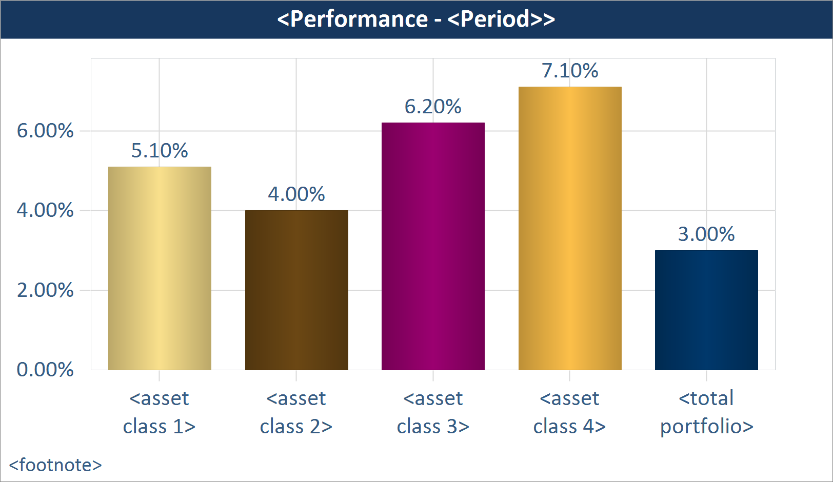
MA
19). Performance – Total with Asset Classes (Chart)
Description: This object displays performance at the total portfolio and asset class levels. **Please Note: In order for this object to display data properly, you must calculate asset class level performance in your portfolio accounting system.
Notes:
** Sort order: default asset class order
**Footnotes – show the performance type based on the setting. If “Since Inception” is selected as a column, then add semi-colon and inception date as below. . If any asset class inception date differs from account inception date, then show the total and asset classes separately as below.
E.g. Inception Date: Total Portfolio – mm/dd/yyyy; Equity – mm/dd/yyyy; etc.
a). Performance is gross/net of fees; Inception Date: mm/dd/yyyy
**Note date format is sensitive to client config. parameter.
Settings:
**Common perf. Settings EXCEPT benchmark selection setting.
Number Formatting
**Decimal places on all columns: Default for % - 2 decimals.

Slide 18
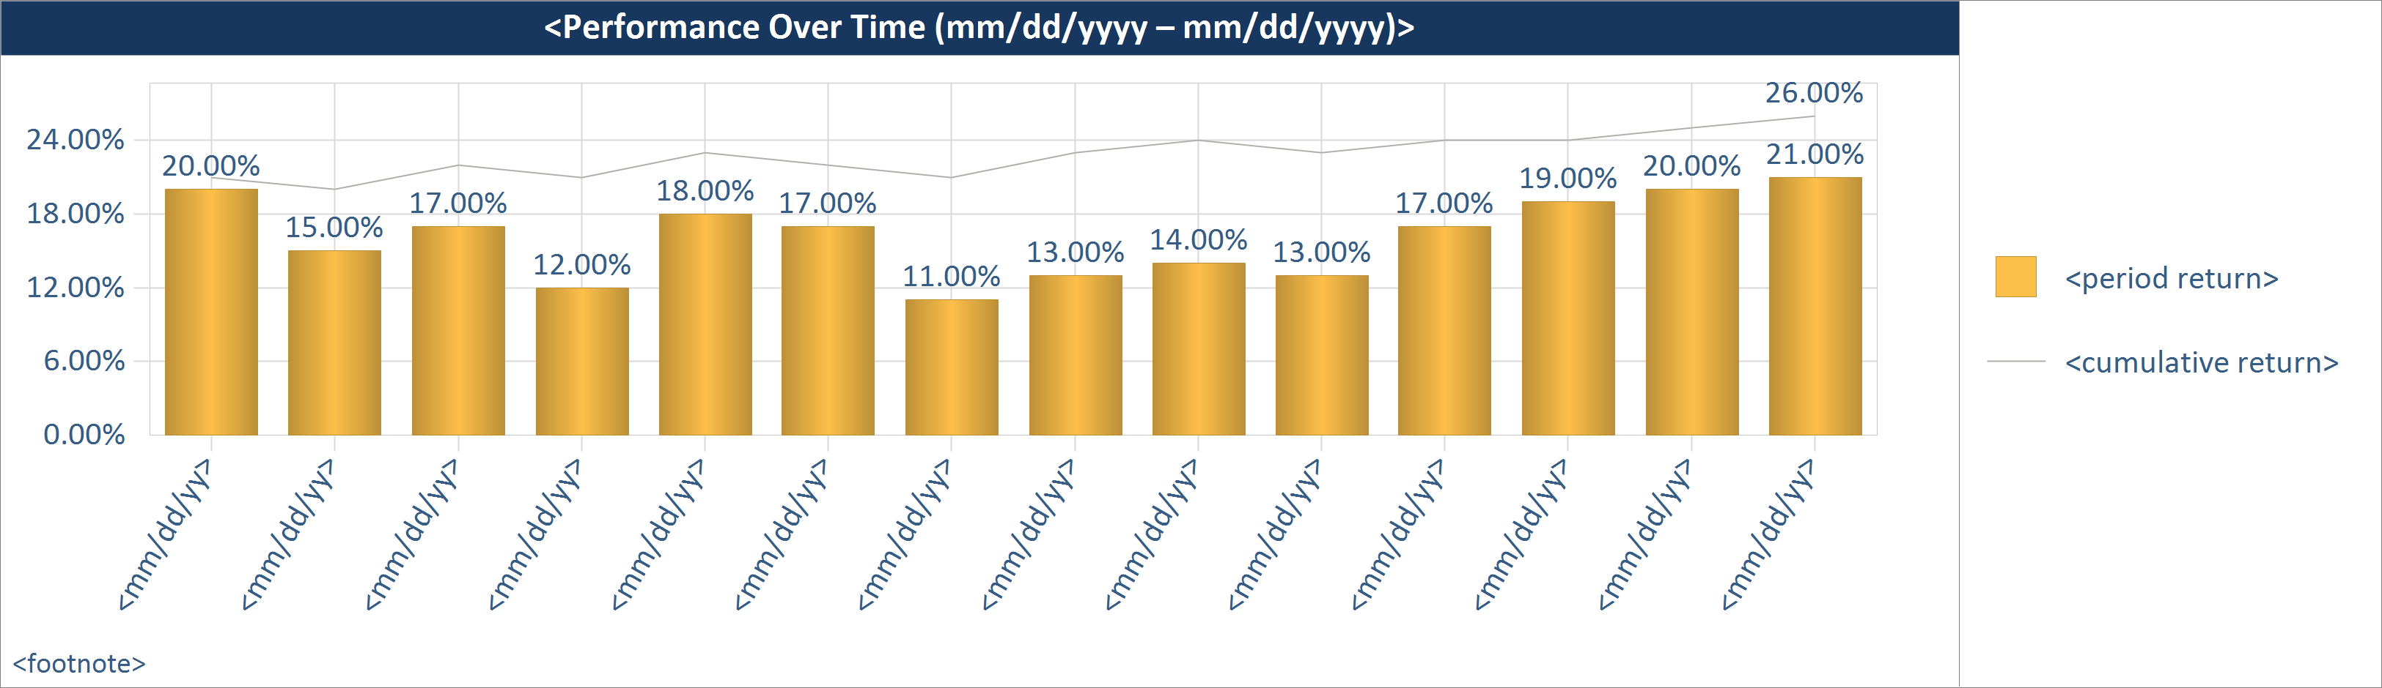
MA
20). Performance – Cumulative and Period Returns Over Time (Chart)
Description: This object shows periods and cumulative returns for a selected time frame.
Notes:
**Footnotes – show the performance type based on the setting.
**Custom NOT available in Easy.
** If ITD setting is selected, and inception date falls mid-period in the first period(x interval), need asterisk on the first period and a footnote saying: Since inception (mm/dd/yyyy). Remember, date format is sensitive to the DisplayDateFormat config. Parameter.
**Legend: 2 colors.
Period Returns
Cumulative Return
**X axis date formats: nQYY; mm/yy; yyyy
**What if the As of Date is a mid way in the Interval? Can we display mm/dd/yyyy then? Rule would be – if As of Date = end of interval, then display interval; else, display date??
Settings:
**Common perf. Settings EXCEPT period benchmark selection setting.
Setting Name: Time period
Type: dropdown
Values (for drop downs): year to date; 1 year trailing; 2 years trailing; 3 years trailing; 4 years trailing; 5 years trailing; 7 years trailing; 10 years trailing; since inception; custom
Default Value: since inception
Help Text: This setting determines the time period displayed on the X-axis. If an option other than “since inception” is selected and the account inception date is after the start of the selected period, then “since inception” will be used as the start of the time period until the selected start date occurs after the inception date.
Need child setting with calendar control if “custom” is selected.
Setting Name: X-axis interval
Type: dropdown
Values (for drop downs): month; quarter; year; default
Default Value: default
Help Text: This setting determines if monthly, quarterly or yearly intervals are displayed on the X axis for time period selected. Selecting “default” will automatically determine the interval as follows – if start of selected time frame is < 1 yr from the reporting date, then months; if between 1 – 3 yrs, then quarters; if > 3 yrs, then years.
Setting Name: Show ending return on line
Type: dropdown
Values (for drop downs): yes; no
Default Value: yes
Help Text: Selecting “yes” will display the cumulative return at the end of the line.
Number Formatting
**Decimal places on all columns: Default for % - 2 decimals.

Slide 19
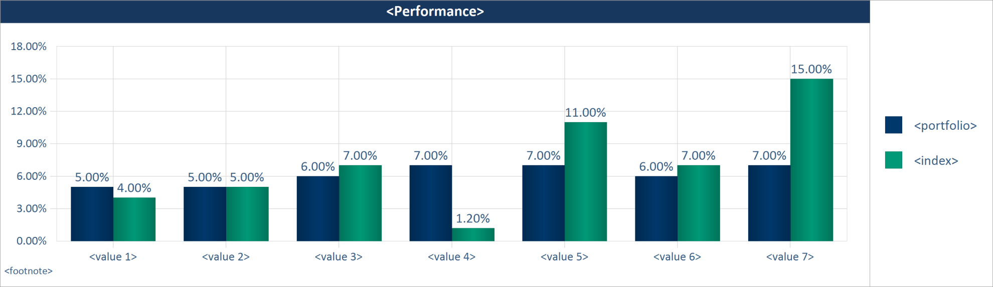
MA
21). Performance – Multiple Periods and Indices (Chart)
Description: This object allows you to select multiple return periods along with up to two indices. Available indices are the ones maintained in your portfolio accounting system.
Settings:
**Common perf. settings
Setting Name: On legend, show
Type: dropdown
Values (for drop downs): “Portfolio”; friendly name; actual account name
Default Value: “Portfolio”
Help Text: This setting determines if the word “Portfolio”, the friendly name or the actual account name is displayed in the chart legend. If you select “friendly name” and If a friendly name is not setup, the actual account name will be used. The friendly names are setup via the Account Administration tool.
Number Formatting
**Decimal places on all columns: Default for % - 2 decimals.
Notes:
**Footnotes – show the performance type based on the setting. If “Since Inception” is selected as a column, then add semi-colon and inception date as below.
a). Performance is gross/net of fees; Inception Date: mm/dd/yyyy
**Note date format is sensitive to client config. parameter.
b). If Blended indices are selected, add a separate footnote line for each blended index as below –
{blended index name}: {component1 name} {%}, {component2 name} {%}, …

Slide 20
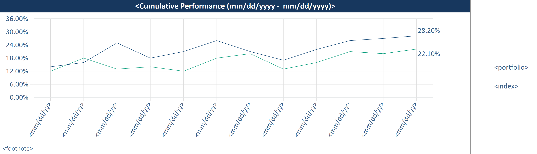
22). Performance – Cumulative Performance with Indices (Chart)
Description: This object shows cumulative performance for a selected time frame for the portfolio and indices.
Notes:
**The chart above is just to illustrate the lines. The Y axis does NOT show returns.
**Footnotes – show the performance type based on the setting.
**Custom NOT available in Easy.
** If ITD setting is selected, and inception date falls mid-period in the first period(x interval), need asterisk on the first period and a footnote saying: Since inception (mm/dd/yyyy). Remember, date format is sensitive to the DisplayDateFormat config. Parameter.
**Display date as mm/dd/yyyy on the X-axis.
**What if the As of Date is a mid way in the Interval? Can we display mm/dd/yyyy then? Rule would be – if As of Date = end of interval, then display interval; else, display date??
Settings:
**Common perf. Settings EXCEPT period selection setting.
Setting Name: Time period
Type: dropdown
Values (for drop downs): year to date; 1 year trailing; 2 years trailing; 3 years trailing; 4 years trailing; 5 years trailing; 7 years trailing; 10 years trailing; since inception; custom
Default Value: since inception
Help Text: This setting determines the time period displayed on the X-axis. If an option other than “since inception” is selected and the account inception date is after the start of the selected period, then “since inception” will be used as the start of the time period until the selected start date occurs after the inception date.
Need child setting with calendar control if “custom” is selected.
Setting Name: X-axis interval
Type: dropdown
Values (for drop downs): month; quarter; year; default
Default Value: default
Help Text: This setting determines if monthly, quarterly or yearly intervals are displayed on the X axis for time period selected. Selecting “default” will automatically determine the interval as follows – if start of selected time frame is < 1 yr from the reporting date, then months; if between 1 – 3 yrs, then quarters; if > 3 yrs, then years.
Setting Name: Show ending return on line
Type: dropdown
Values (for drop downs): on chart; in legend; no
Default Value: on chart
Help Text: Help Text: Selecting “on chart” will display ending returns at end of the lines. Selecting “in legend” will display ending returns in the legend in parenthesis. The inclusion/exclusion of the $ sign is inherited from the value you set for the “Y axis sign” setting.
Setting Name: On legend, show
Type: dropdown
Values (for drop downs): “Portfolio”; friendly name; actual account name
Default Value: “Portfolio”
Help Text: This setting determines if the word “Portfolio”, the friendly name or the actual account name is displayed in the chart legend. If you select “friendly name” and If a friendly name is not setup, the actual account name will be used. The friendly names are setup via the Account Administration tool.
Number Formatting
**Decimal places on all columns: Default for % - 2 decimals.

Slide 21
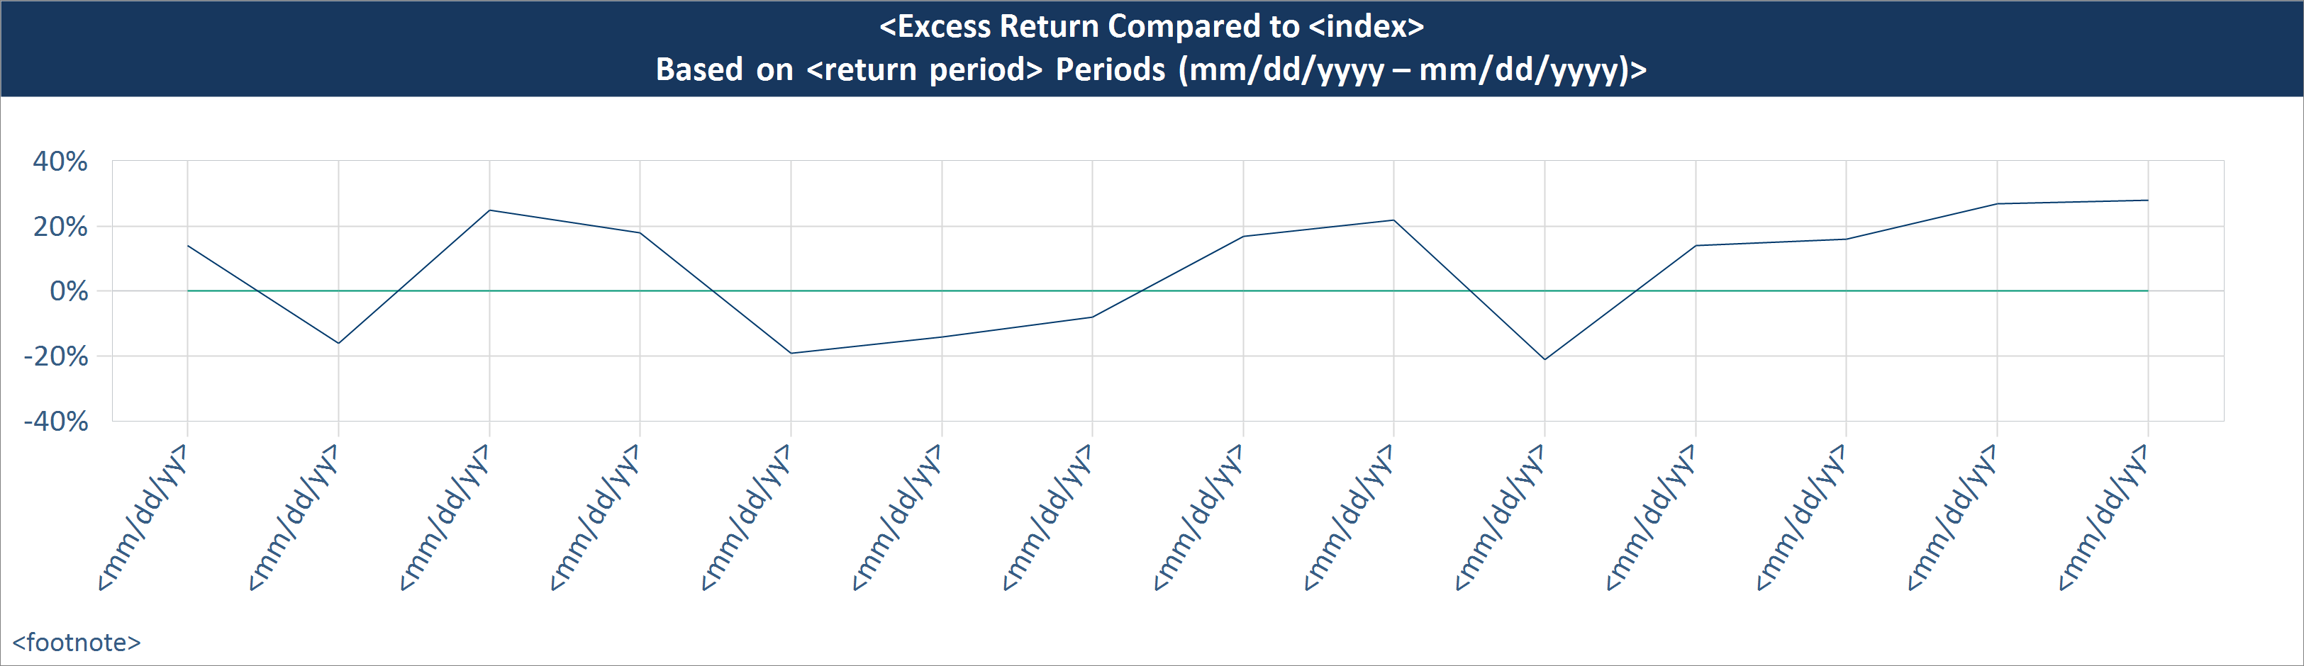
23). Performance – Excess Return Over Time, Line Chart (Chart)
Description: This object shows the excess return of the portfolio compared to a benchmark for a selected time period. You can specify the return period.
Notes:
On chart – need to draw the index line on 0% ; no need legend by default
**Footnotes – show the performance type based on the setting.
**Custom NOT available in Easy.
**What if the As of Date is a mid way in the Interval? Can we display mm/dd/yyyy then? Rule would be – if As of Date = end of interval, then display interval; else, display date??
Settings:
**Common perf. Settings ; ** EXCEPT period selection setting. ONE benchmark setting
Setting Name: Return period
Type: dropdown
Values (for drop downs): same as interval; rolling 1 year; rolling 2 year annualized; rolling 3 year annualized; rolling 5 year annualized; rolling 7 year annualized; rolling 10 year annualized; custom
Default Value: rolling 3 year annualized
Help Text: For the return period selected, the excess return (difference between portfolio return and return of the selected benchmark) for each interval will be plotted. If you select “same as interval” the return will be for the value selected in the “Interval” setting below. **Please note: On the reporting date, if the account has not been open for the return period selected, this objects will NOT be generated. For example, if “rolling 3 year annualized” is selected, and the account is younger than 3 years, this object will not be generated.
If custom is selected, display numeric entry box with “Custom rolling period:”
Setting Name: Time period
Type: dropdown
Values (for drop downs): 1 year trailing; 2 years trailing; 3 years trailing; 4 years trailing; 5 years trailing; 7 years trailing; 10 years trailing; since inception; custom
Default Value: 5 years trailing
Help Text: This setting determines the time period displayed on the X-axis.
Need child setting with calendar control if “custom” is selected.
Setting Name: Interval
Type: dropdown
Values (for drop downs): month; quarter; year
Default Value: quarter
Help Text: This setting determines if monthly, quarterly or yearly intervals are displayed on the X axis for the time period selected. The selected return will be calculated as of the end of each interval.
Setting Name: Show composite data
Type: dropdown
Values (for drop downs): yes; no
Default Value: yes
Help Text: This setting applies to client accounts (non-composites). When generating reports for an account, if data displayed in this object is available for the account, then the account specific data will be used. Instead, if you want to display composite-level data, then select “yes” here – the data for the composite the account belongs to will be displayed. If you do not send account-level data for this object, then composite-level data will be used automatically. When generating reports for a composite, the actual composite data will be used (as long as the data is sent to Assette) irrespective of the selection. If you select to display composite data, you may select to display the footnote “Portfolio data is based on <composite name> data”. If there is no account data, and composite data is displayed, then the footnote will automatically be displayed.
  Setting Name: Display footnote
  Type: dropdown
  Values (for drop downs): yes; no
  Default Value: yes
Setting Name: On legend, show
Type: dropdown
Values (for drop downs): “Portfolio”; friendly name; actual account name
Default Value: “Portfolio”
Help Text: This setting determines if the word “Portfolio”, “Composite”, the friendly name or the actual account name is displayed in the chart legend. If you select “friendly name” and If a friendly name is not setup, the actual account name will be used. The friendly names are setup via the Account Administration tool.
Number Formatting
**Decimal places on all columns: Default for % - 2 decimals.

Slide 22
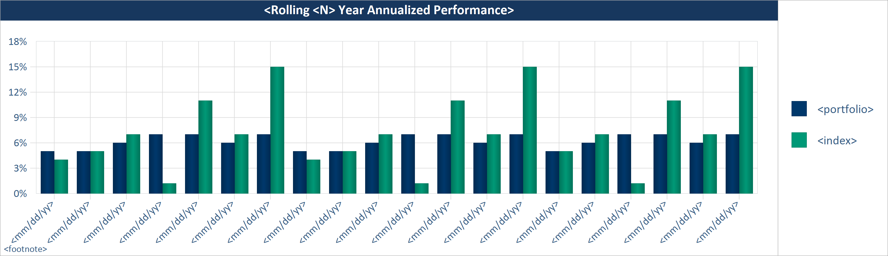
24). Performance – Performance Over Time (Chart)
Description: This object shows the returns for the portfolio and indices over a time period for intervals you specify. You can specify the return period.
Notes:
Chart title change: <<return period> Performance (mm/dd/yyyy – mm/dd/yyyy)>
**Footnotes – show the performance type based on the setting.
**Custom NOT available in Easy.
**What if the As of Date is a mid way in the Interval? Can we display mm/dd/yyyy then? Rule would be – if As of Date = end of interval, then display interval; else, display date??
Settings:
**Common perf. Settings EXCEPT period; ONE benchmark selection setting.
Setting Name: Return Period
Type: dropdown
Values (for drop downs): same as interval; rolling 1 year; rolling 2 year annualized; rolling 3 year annualized; rolling 5 year annualized; rolling 7 year annualized; rolling 10 year annualized; custom
Default Value: rolling 3 year annualized
Help Text: For the return period selected, the excess return (difference between portfolio return and return of the selected benchmark) for each interval will be plotted. If you select “same as interval” the return will be for the value selected in the “Interval” setting below. **Please note: On the reporting date, if the account has not been open for the return period selected, this objects will NOT be generated. For example, if “rolling 3 year annualized” is selected, and the account is younger than 3 years, this object will not be generated.
If custom is selected, display numeric entry box with “Custom rolling period:”
Setting Name: Time period
Type: dropdown
Values (for drop downs): 1 year trailing; 2 years trailing; 3 years trailing; 4 years trailing; 5 years trailing; 7 years trailing; 10 years trailing; since inception; custom
Default Value: 5 years trailing
Help Text: This setting determines the time period displayed on the X-axis.
Need child setting with calendar control if “custom” is selected.
Setting Name: Interval
Type: dropdown
Values (for drop downs): month; quarter; year
Default Value: quarter
Help Text: This setting determines if monthly, quarterly or yearly intervals are displayed on the X axis for the time period selected. The selected return will be calculated as of the end of each interval.
Setting Name: Show composite data
Type: dropdown
Values (for drop downs): yes; no
Default Value: yes
Help Text: This setting applies to client accounts (non-composites). When generating reports for an account, if data displayed in this object is available for the account, then the account specific data will be used. Instead, if you want to display composite-level data, then select “yes” here – the data for the composite the account belongs to will be displayed. If you do not send account-level data for this object, then composite-level data will be used automatically. When generating reports for a composite, the actual composite data will be used (as long as the data is sent to Assette) irrespective of the selection. If you select to display composite data, you may select to display the footnote “Portfolio data is based on <composite name> data”. If there is no account data, and composite data is displayed, then the footnote will automatically be displayed.
  Setting Name: Display footnote
  Type: dropdown
  Values (for drop downs): yes; no
  Default Value: yes
Setting Name: On legend, show
Type: dropdown
Values (for drop downs): “Portfolio”; friendly name; actual account name
Default Value: “Portfolio”
Help Text: This setting determines if the word “Portfolio”, “Composite”, the friendly name or the actual account name is displayed in the chart legend. If you select “friendly name” and If a friendly name is not setup, the actual account name will be used. The friendly names are setup via the Account Administration tool.
Number Formatting
**Decimal places on all columns: Default for % - 2 decimals.

Slide 23
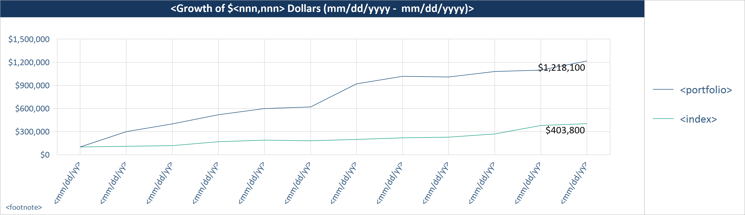
25). Performance – Growth of a Dollar, Line Chart (Chart)
Description: This object displays the growth of a dollar amount based on the portfolio return and selected index return. You can enter the starting dollar value.
Notes:
**Y Axis – if start value is large, may have to show “$ MM” and show smaller number.
**Footnotes – show the performance type based on the setting.
**Custom NOT available in Easy.
** If ITD setting is selected, and inception date falls mid-period in the first period(x interval), need asterisk on the first period and a footnote saying: Since inception (mm/dd/yyyy). Remember, date format is sensitive to the DisplayDateFormat config. Parameter.
**Display date as mm/dd/yyyy on the X-axis.
**What if the As of Date is a mid way in the Interval? Can we display mm/dd/yyyy then? Rule would be – if As of Date = end of interval, then display interval; else, display date??
Settings:
**Common perf. Settings EXCEPT period selection setting. **ONE benchmark.
Setting Name: Start amount ($)
Type: numeric entry box
Default Value: 10,000
Help Text:
Setting Name: Time period
Type: dropdown
Values (for drop downs): year to date; 1 year trailing; 2 years trailing; 3 years trailing; 4 years trailing; 5 years trailing; 7 years trailing; 10 years trailing; since inception; custom
Default Value: since inception
Help Text: This setting determines the time period displayed on the X-axis. If an option other than “since inception” is selected and the account inception date is after the start of the selected period, then “since inception” will be used as the start of the time period until the selected start date occurs after the inception date.
Need child setting with calendar control if “custom” is selected.
Setting Name: X-axis interval
Type: dropdown
Values (for drop downs): month; quarter; year; default
Default Value: default
Help Text: This setting determines if monthly, quarterly or yearly intervals are displayed on the X axis for time period selected. Selecting “default” will automatically determine the interval as follows – if start of selected time frame is < 1 yr from the reporting date, then months; if between 1 – 3 yrs, then quarters; if > 3 yrs, then years.
Setting Name: Show ending values
Type: dropdown
Values (for drop downs): on chart; in legend; no
Default Value: on chart
Help Text: Help Text: Selecting “on chart” will display ending values at end of the lines. Selecting “in legend” will display ending values in the legend in parenthesis. The inclusion/exclusion of the $ sign is inherited from the value you set for the “Y axis sign” setting.
Setting Name: On legend, show
Type: dropdown
Values (for drop downs): “Portfolio”; friendly name; actual account name
Default Value: “Portfolio”
Help Text: This setting determines if the word “Portfolio”, “Composite”, the friendly name or the actual account name is displayed in the chart legend. If you select “friendly name” and If a friendly name is not setup, the actual account name will be used. The friendly names are setup via the Account Administration tool.
.
Number Formatting
**Decimal places on all columns: Default for % - 2 decimals.

Slide 24
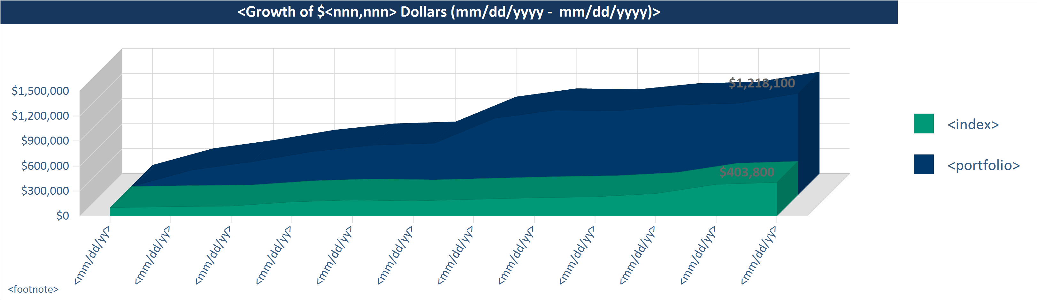
26). Performance – Growth of a Dollar, 3D Area Chart (Chart)
Description: This object displays the growth of a dollar amount based on the portfolio return and selected index return. You can enter the starting dollar value.
Notes:
**Y Axis – if start value is large, may have to show “$ MM” and show smaller number.
**Footnotes – show the performance type based on the setting.
**Custom NOT available in Easy.
** If ITD setting is selected, and inception date falls mid-period in the first period(x interval), need asterisk on the first period and a footnote saying: Since inception (mm/dd/yyyy). Remember, date format is sensitive to the DisplayDateFormat config. Parameter.
**Display date as mm/dd/yyyy on the X-axis.
**What if the As of Date is a mid way in the Interval? Can we display mm/dd/yyyy then? Rule would be – if As of Date = end of interval, then display interval; else, display date??
Settings:
**Common perf. Settings EXCEPT period selection setting. **ONE benchmark.
Setting Name: Start amount ($)
Type: numeric entry box
Default Value: 10,000
Help Text:
Setting Name: Time period
Type: dropdown
Values (for drop downs): year to date; 1 year trailing; 2 years trailing; 3 years trailing; 4 years trailing; 5 years trailing; 7 years trailing; 10 years trailing; since inception; custom
Default Value: since inception
Help Text: This setting determines the time period displayed on the X-axis. If an option other than “since inception” is selected and the account inception date is after the start of the selected period, then “since inception” will be used as the start of the time period until the selected start date occurs after the inception date.
Need child setting with calendar control if “custom” is selected.
Setting Name: X-axis interval
Type: dropdown
Values (for drop downs): month; quarter; year; default
Default Value: default
Help Text: This setting determines if monthly, quarterly or yearly intervals are displayed on the X axis for time period selected. Selecting “default” will automatically determine the interval as follows – if start of selected time frame is < 1 yr from the reporting date, then months; if between 1 – 3 yrs, then quarters; if > 3 yrs, then years.
Setting Name: Show ending values
Type: dropdown
Values (for drop downs): yes; no
Default Value: yes
Help Text: Help Text: Selecting “yes” will display ending values end of the areas. The inclusion/exclusion of the $ sign is inherited from the value you set for the “Y axis sign” setting.
Setting Name: On legend, show
Type: dropdown
Values (for drop downs): “Portfolio”; friendly name; actual account name
Default Value: “Portfolio”
Help Text: This setting determines if the word “Portfolio”, “Composite”, the friendly name or the actual account name is displayed in the chart legend. If you select “friendly name” and If a friendly name is not setup, the actual account name will be used. The friendly names are setup via the Account Administration tool.
Number Formatting
**Decimal places on all columns: Default for % - 2 decimals.

Slide 25
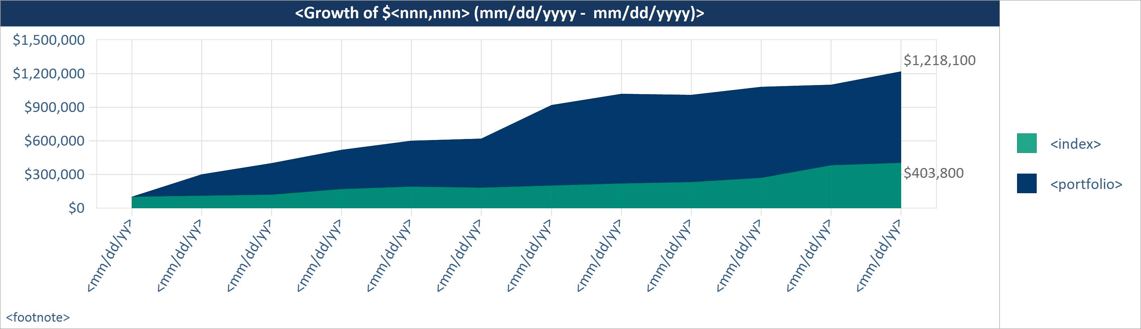
MA
27). Performance – Growth of a Dollar, Area Chart (Chart)
Description: This object displays the growth of a dollar amount based on the portfolio return and selected index return. You can enter the starting dollar value.
Notes:
**Y Axis – if start value is large, may have to show “$ MM” and show smaller number.
**Footnotes – show the performance type based on the setting.
**Custom NOT available in Easy.
** If ITD setting is selected, and inception date falls mid-period in the first period(x interval), need asterisk on the first period and a footnote saying: Since inception (mm/dd/yyyy). Remember, date format is sensitive to the DisplayDateFormat config. Parameter.
**Display date as mm/dd/yyyy on the X-axis.
**What if the As of Date is a mid way in the Interval? Can we display mm/dd/yyyy then? Rule would be – if As of Date = end of interval, then display interval; else, display date??
Settings:
**Common perf. Settings EXCEPT period selection setting. **ONE benchmark.
Setting Name: Start amount ($)
Type: numeric entry box
Default Value: 10,000
Help Text:
Setting Name: Time period
Type: dropdown
Values (for drop downs): year to date; 1 year trailing; 2 years trailing; 3 years trailing; 4 years trailing; 5 years trailing; 7 years trailing; 10 years trailing; since inception; custom
Default Value: since inception
Help Text: This setting determines the time period displayed on the X-axis. If an option other than “since inception” is selected and the account inception date is after the start of the selected period, then “since inception” will be used as the start of the time period until the selected start date occurs after the inception date.
Need child setting with calendar control if “custom” is selected.
Setting Name: X-axis interval
Type: dropdown
Values (for drop downs): month; quarter; year; default
Default Value: default
Help Text: This setting determines if monthly, quarterly or yearly intervals are displayed on the X axis for time period selected. Selecting “default” will automatically determine the interval as follows – if start of selected time frame is < 1 yr from the reporting date, then months; if between 1 – 3 yrs, then quarters; if > 3 yrs, then years.
Setting Name: Show ending values
Type: dropdown
Values (for drop downs): on chart; in legend; no
Default Value: on chart
Help Text: Help Text: Selecting “on chart” will display ending values at end of the areas. Selecting “in legend” will display ending values in the legend in parenthesis. The inclusion/exclusion of the $ sign is inherited from the value you set for the “Y axis sign” setting.
Setting Name: On legend, show
Type: dropdown
Values (for drop downs): “Portfolio”; friendly name; actual account name
Default Value: “Portfolio”
Help Text: This setting determines if the word “Portfolio”, “Composite”, the friendly name or the actual account name is displayed in the chart legend. If you select “friendly name” and If a friendly name is not setup, the actual account name will be used. The friendly names are setup via the Account Administration tool.
Number Formatting
**Decimal places on all columns: Default for % - 2 decimals.

Slide 26
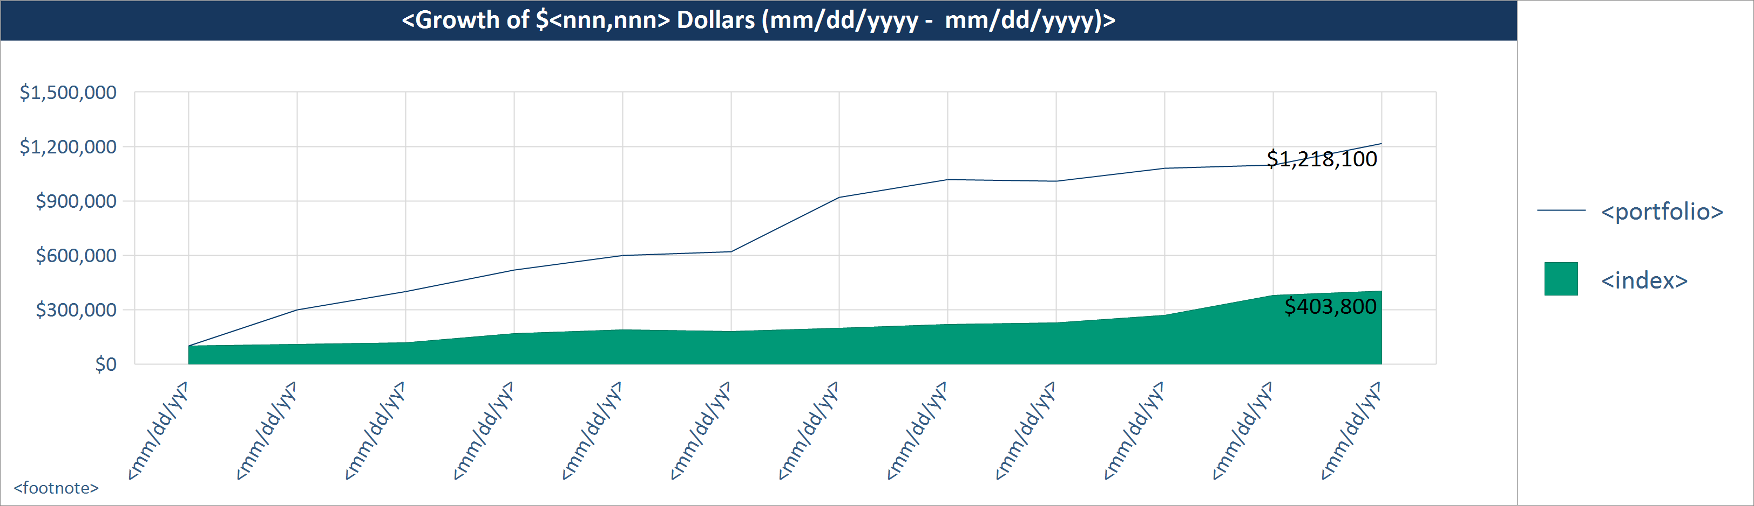
MA
28). Performance – Growth of a Dollar, Line and Area Chart (Chart)
Description: This object displays the growth of a dollar amount based on the portfolio return and selected index return. You can enter the starting dollar value.
Notes:
**Y Axis – if start value is large, may have to show “$ MM” and show smaller number.
**Footnotes – show the performance type based on the setting.
**Custom NOT available in Easy.
** If ITD setting is selected, and inception date falls mid-period in the first period(x interval), need asterisk on the first period and a footnote saying: Since inception (mm/dd/yyyy). Remember, date format is sensitive to the DisplayDateFormat config. Parameter.
**Display date as mm/dd/yyyy on the X-axis.
**What if the As of Date is a mid way in the Interval? Can we display mm/dd/yyyy then? Rule would be – if As of Date = end of interval, then display interval; else, display date??
Settings:
**Common perf. Settings EXCEPT period selection setting. **ONE benchmark.
Setting Name: Start amount ($)
Type: numeric entry box
Default Value: 10,000
Help Text:
Setting Name: Time period
Type: dropdown
Values (for drop downs): year to date; 1 year trailing; 2 years trailing; 3 years trailing; 4 years trailing; 5 years trailing; 7 years trailing; 10 years trailing; since inception; custom
Default Value: since inception
Help Text: This setting determines the time period displayed on the X-axis. If an option other than “since inception” is selected and the account inception date is after the start of the selected period, then “since inception” will be used as the start of the time period until the selected start date occurs after the inception date.
Need child setting with calendar control if “custom” is selected.
Setting Name: X-axis interval
Type: dropdown
Values (for drop downs): month; quarter; year; default
Default Value: default
Help Text: This setting determines if monthly, quarterly or yearly intervals are displayed on the X axis for time period selected. Selecting “default” will automatically determine the interval as follows – if start of selected time frame is < 1 yr from the reporting date, then months; if between 1 – 3 yrs, then quarters; if > 3 yrs, then years.
Setting Name: Show ending values
Type: dropdown
Values (for drop downs): on chart; in legend; no
Default Value: on chart
Help Text: Help Text: Selecting “on chart” will display ending values at end of the areas. Selecting “in legend” will display ending values in the legend in parenthesis. The inclusion/exclusion of the $ sign is inherited from the value you set for the “Y axis sign” setting.
Setting Name: On legend, show
Type: dropdown
Values (for drop downs): “Portfolio”; friendly name; actual account name
Default Value: “Portfolio”
Help Text: This setting determines if the word “Portfolio”, “Composite”, the friendly name or the actual account name is displayed in the chart legend. If you select “friendly name” and If a friendly name is not setup, the actual account name will be used. The friendly names are setup via the Account Administration tool.
Number Formatting
**Decimal places on all columns: Default for % - 2 decimals.

Slide 27
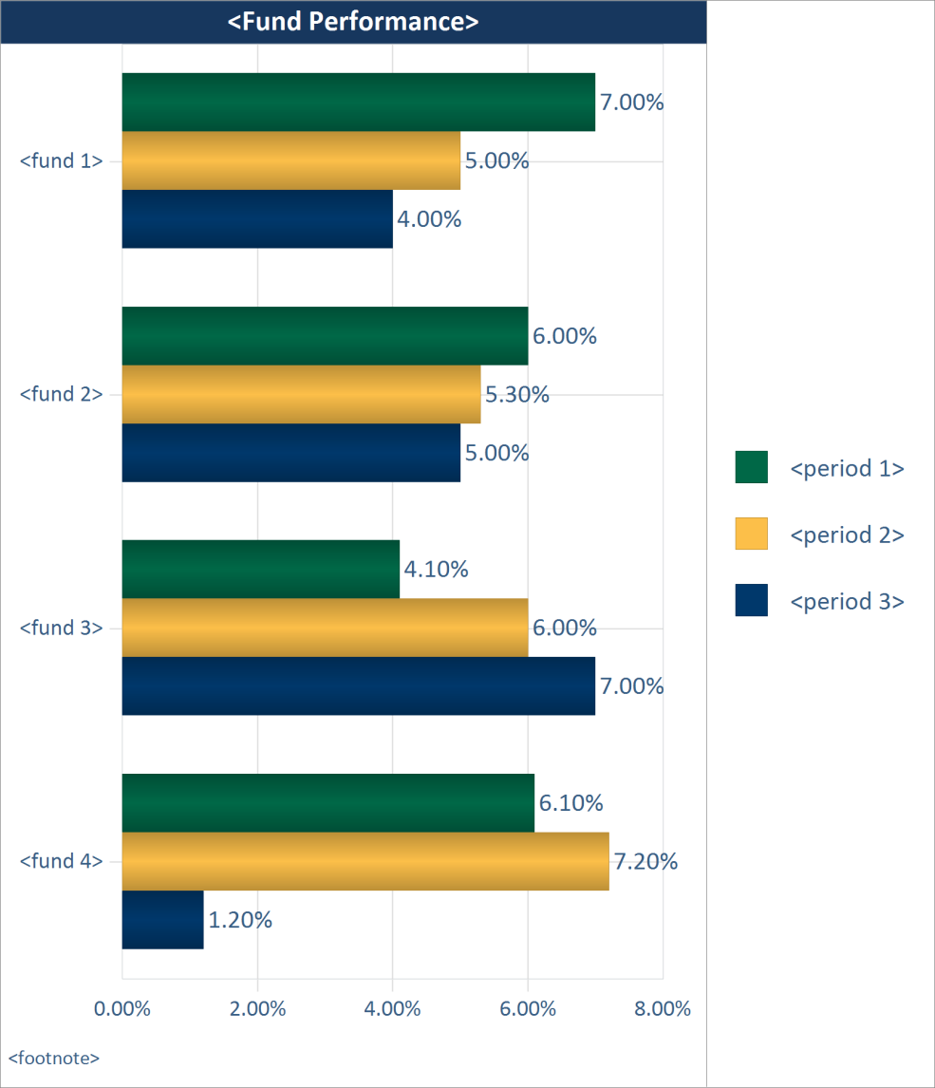
MA
29). Performance – Fund Performance (Chart)
Description: This object displays up to three periods of performance for any funds held in the portfolio. Fund performance is irrespective of the portfolio’s actual holding period. **Please Note: In order for this object to display data, Assette needs to receive fund performance.
Settings:
**Common perf. Settings **See comment on left re: periods and settings values. Ability to select up to 3 periods.
Number Formatting
**Decimal places on all columns: Default for % - 2 decimals.
Notes:
** Y axis Sort order: value, DSC ; Sort order for periods: shortest period to longest (shortest bar will be first one).
Sorting should be top to bottom in legend
**Footnotes – show the performance type based on the setting.
**Need to keep Security Type to identify Funds as Client Config. Parameter (we can have defaults for Axys, APX and PC).
**This object should ONLY show certain periods as settings values. We should stick to the 6 periods we extract via extensions, and make the fund perf. Excel template have only these 6.

Slide 28
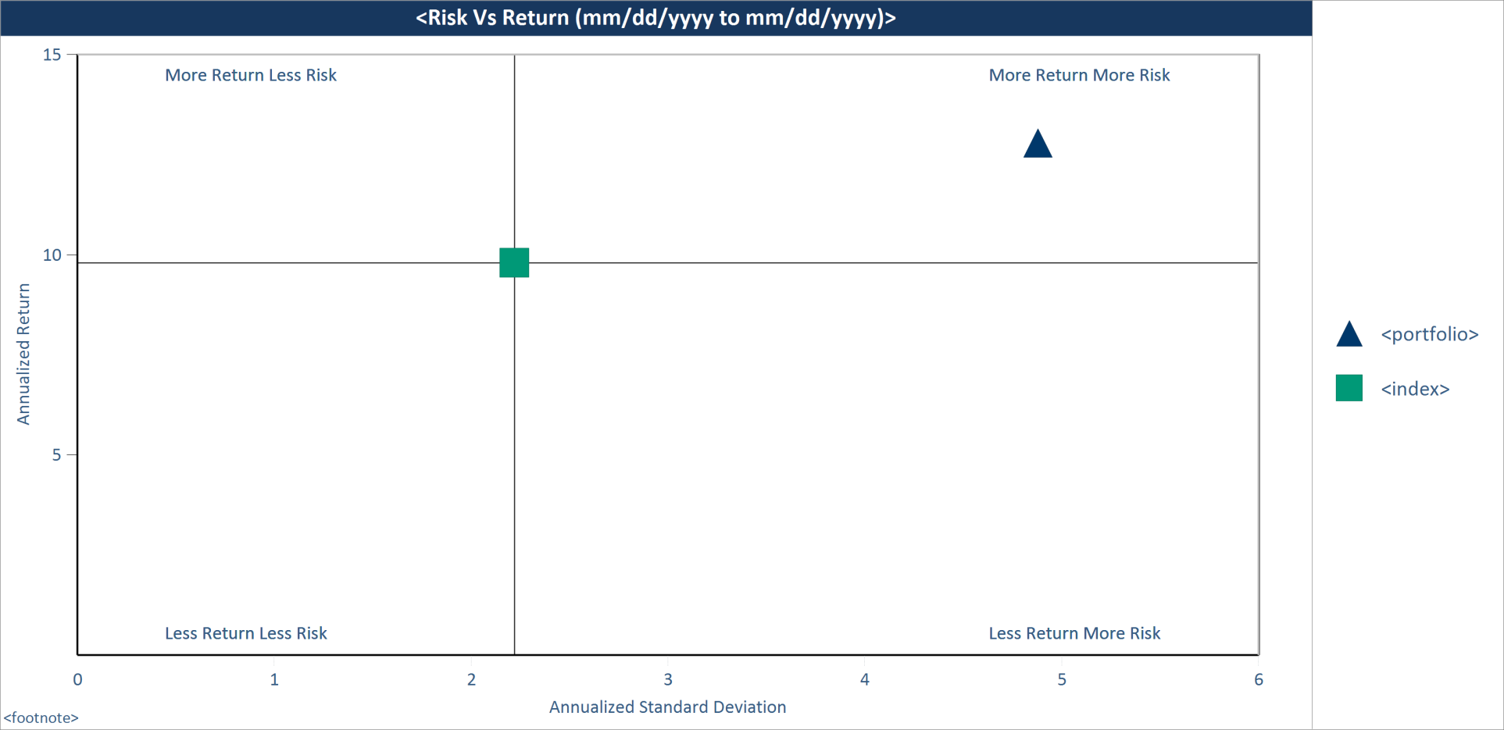
30). Performance – Risk Vs Return (Chart)
Description: This object displays the risk and return of the portfolio compared to indices. You may select up to 3 indices.
Settings:
**Common perf. Settings EXCEPT period selection setting.
Setting Name: Time period
Type: dropdown
Values (for drop downs): year to date; 1 year trailing; 2 years trailing; 3 years trailing; 4 years trailing; 5 years trailing; 7 years trailing; 10 years trailing; since inception; custom
Default Value: since inception
Help Text: If an option other than “since inception” is selected and the account inception date is after the start of the selected period, then “since inception” will be used as the start of the time period until the selected start date occurs after the inception date.
Need child setting with calendar control if “custom” is selected.
Setting Name: Show composite data
Type: dropdown
Values (for drop downs): yes; no
Default Value: yes
Help Text: This setting applies to client accounts (non-composites). When generating reports for an account, if data displayed in this object is available for the account, then the account specific data will be used. Instead, if you want to display composite-level data, then select “yes” here – the data for the composite the account belongs to will be displayed. If you do not send account-level data for this object, then composite-level data will be used automatically. When generating reports for a composite, the actual composite data will be used (as long as the data is sent to Assette) irrespective of the selection. If you select to display composite data, you may select to display the footnote “Portfolio data is based on <composite name> data”. If there is no account data, and composite data is displayed, then the footnote will automatically be displayed.
  Setting Name: Display footnote
  Type: dropdown
  Values (for drop downs): yes; no
  Default Value: yes
Setting Name: On legend, show
Type: dropdown
Values (for drop downs): “Portfolio”; friendly name; actual account name
Default Value: “Portfolio”
Help Text: This setting determines if the word “Portfolio”, “Composite”, the friendly name or the actual account name is displayed in the chart legend. If you select “friendly name” and If a friendly name is not setup, the actual account name will be used. The friendly names are setup via the Account Administration tool.
Number Formatting
**Decimal places on all columns: Default for % - 2 decimals.
Notes:
**Footnotes – show the performance type based on the setting.
We have to add a setting to support 2 additional indices (3 total). 2 & 3 can be “keep blank”, hence the shell doesn’t need to change.

Slide 29
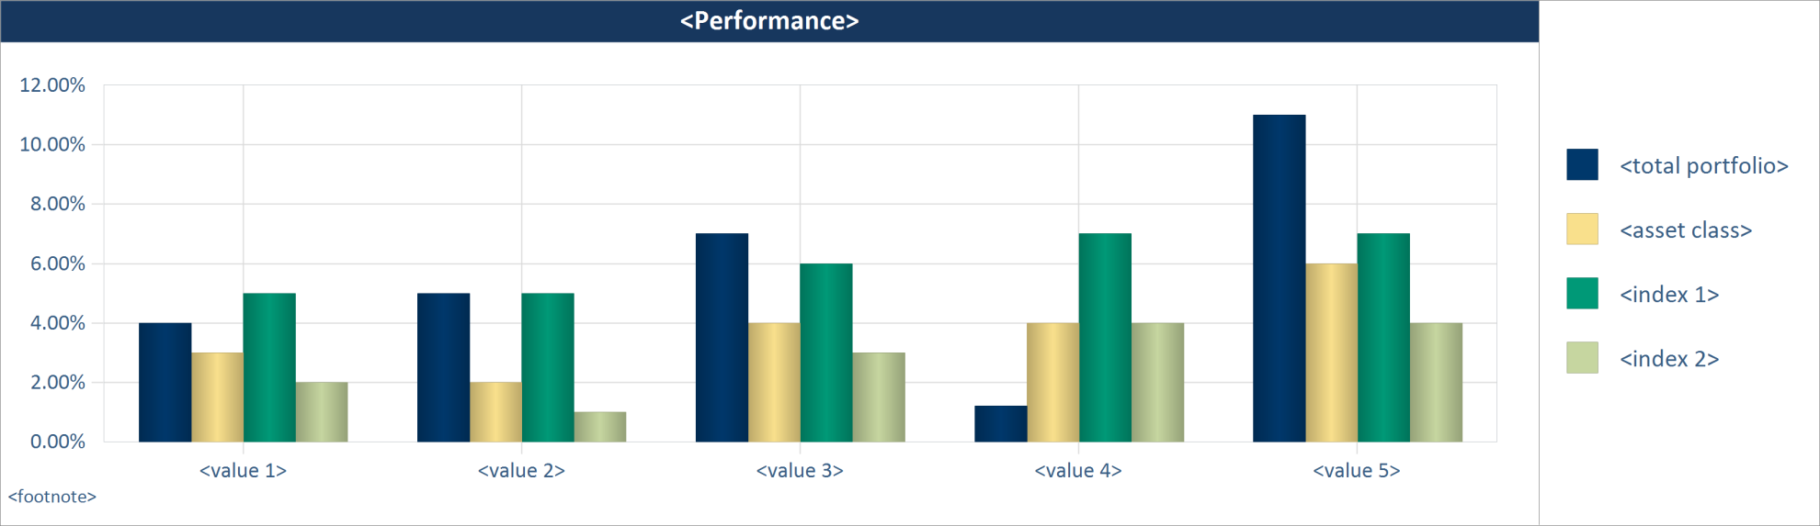
31). Performance – One Asset Class with Total and Indices (Chart)
Description: This object displays performance for the total portfolio and one asset class along with up to two indices. **Please Note: In order for this object to display data properly, you must calculate asset class level performance in your portfolio accounting system.
Notes:
Shell: why aren’t we showing bar values on top of each bar? Is this intentional? If yes, make sure setting default is set as such. If not, need to add bar values to shell.
**Footnotes – show the performance type based on the setting. If “Since Inception” is selected as a column, then add semi-colon and inception date as below. . If any asset class inception date differs from account inception date, then show the total and asset classes separately as below.
E.g. Inception Date: Total Portfolio – mm/dd/yyyy; Equity – mm/dd/yyyy; etc.
a). Performance is gross/net of fees; Inception Date: mm/dd/yyyy
**Note date format is sensitive to client config. parameter
L&F:
a). Show only 5 periods. Each period will show 4 bars.
b). Colors are: Total prtf. (as above); asset class 1; index 1; index 2
c). Legend: <Total Portfolio>; <asset class>.
d). If values on top of bars start to cut into other bars, please reduce font size and note down the size as an exception for this chart.
Settings:
**Common perf. Settings
Setting Name: Asset class
Type: dropdown
Values (for drop downs): {list of asset classes with perf.}
Default Value: {first in list}
Help Text:
Number Formatting
**Decimal places on all columns: Default for % - 2 decimals.

Slide 30
1). Characteristics – Portfolio Characteristics, Equity (Table)
Description: This object displays equity characteristics for the portfolio and up to two indices. **Please Note: Characteristics data must be sent to Assette for this object to display data.
<Portfolio Characteristics>
Characteristics (<type>) | <prtf.> | <index 1> | <index 2>
<characteristic> | <nnn> | <nnn> | <nnn>
<characteristic> | <nnn> | <nnn> | <nnn>
<characteristic> | <nnn> | <nnn> | <nnn>
<characteristic> | <nnn> | <nnn> | <nnn>
<characteristic> | <nnn> | <nnn> | <nnn>
<characteristic> | <nnn> | <nnn> | <nnn>
<characteristic> | <nnn> | <nnn> | <nnn>
<characteristic> | <nnn> | <nnn> | <nnn>
<characteristic> | <nnn> | <nnn> | <nnn>
<characteristic> | <nnn> | <nnn> | <nnn>
<footnotes>
Settings:
**Perf. Setting to select “Show data as of”. **quarter-end is the default.
Setting Name: Show composite data
Type: dropdown
Values (for drop downs): yes; no
Default Value: yes
Help Text: This setting applies to client accounts (non-composites). When generating reports for an account, if data displayed in this object is available for the account, then the account specific data will be used. Instead, if you want to display composite-level data, then select “yes” here – the data for the composite the account belongs to will be displayed. If you do not send account-level data for this object, then composite-level data will be used automatically. When generating reports for a composite, the actual composite data will be used (as long as the data is sent to Assette) irrespective of the selection. If you select to display composite data, you may select to display the footnote “Portfolio data is based on <composite name> data”. If there is no account data, and composite data is displayed, then the footnote will automatically be displayed.
  Setting Name: Display footnote
  Type: dropdown
  Values (for drop downs): yes; no
  Default Value: yes
Setting Name: Characteristic type
Type: dropdown
Values (for drop downs): average; median {types sent by client}
Default Value: average
Help Text: Only types you send to Assette are displayed here. If you only send one type, you may not see options in the dropdown list.
Setting Name: Characteristic 1
Type: dropdown
Values (for drop downs): keep blank; {list of characteristics received from client}
Default Value: keep blank
Help Text:
…..
Setting Name: Characteristic 10
Setting Name: Index 1
Type: dropdown
Values (for drop downs): keep blank; default 1; default 2; {list of equity benchmarks that have characteristics}
Default Value: default 1
Help Text: Selecting one of the “default” values will display benchmarks associated with the account in your portfolio accounting system. “Default 1” will display the first benchmark associated with the account, “default 2” will display the second one and so on. **Please Note: Assette must receive characteristics for indices that are represented by “default”.
…
Setting Name: Index 2 (keep blank; and the same list above. Default = keep blank).
Help Text: If you want to show only one index, then select “keep blank” here - even though the <index 2> column is visible in the template, the generated report will NOT have this column.
Setting Name: On portfolio column, show
Type: dropdown
Values (for drop downs): “Portfolio”; friendly name; actual account name
Default Value: “Portfolio”
Help Text: This setting determines if the word “Portfolio”, the friendly name or the actual account name is displayed. If you select “friendly name” and If a friendly name is not setup, the actual account name will be used. The friendly names are setup via the Account Administration tool.
Notes:
**NEED TO CONSUME: DisplayName; Decimal Places and Suffix from DB (see CIPT)

